Slide 1
IBM Cloud / Github Classroom Primer
COMP 4970/7970/7976
Rodrigo Sardinas

Slide 2
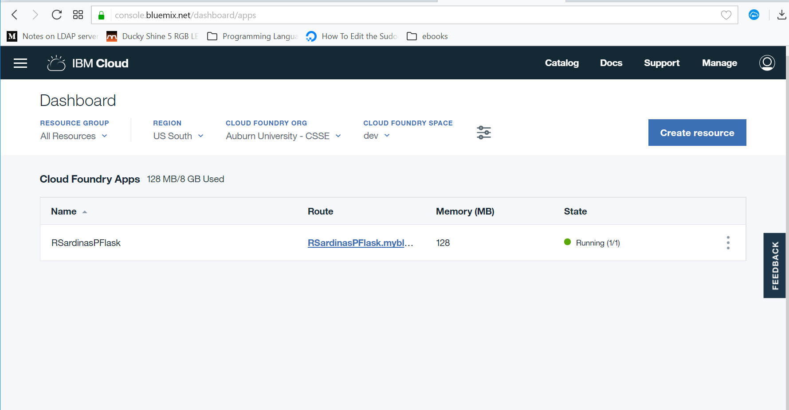
Getting Around the Dashboard
Notes:
Point out:
Resource Group
Region
Org
Space

Slide 3
New Application

Slide 4
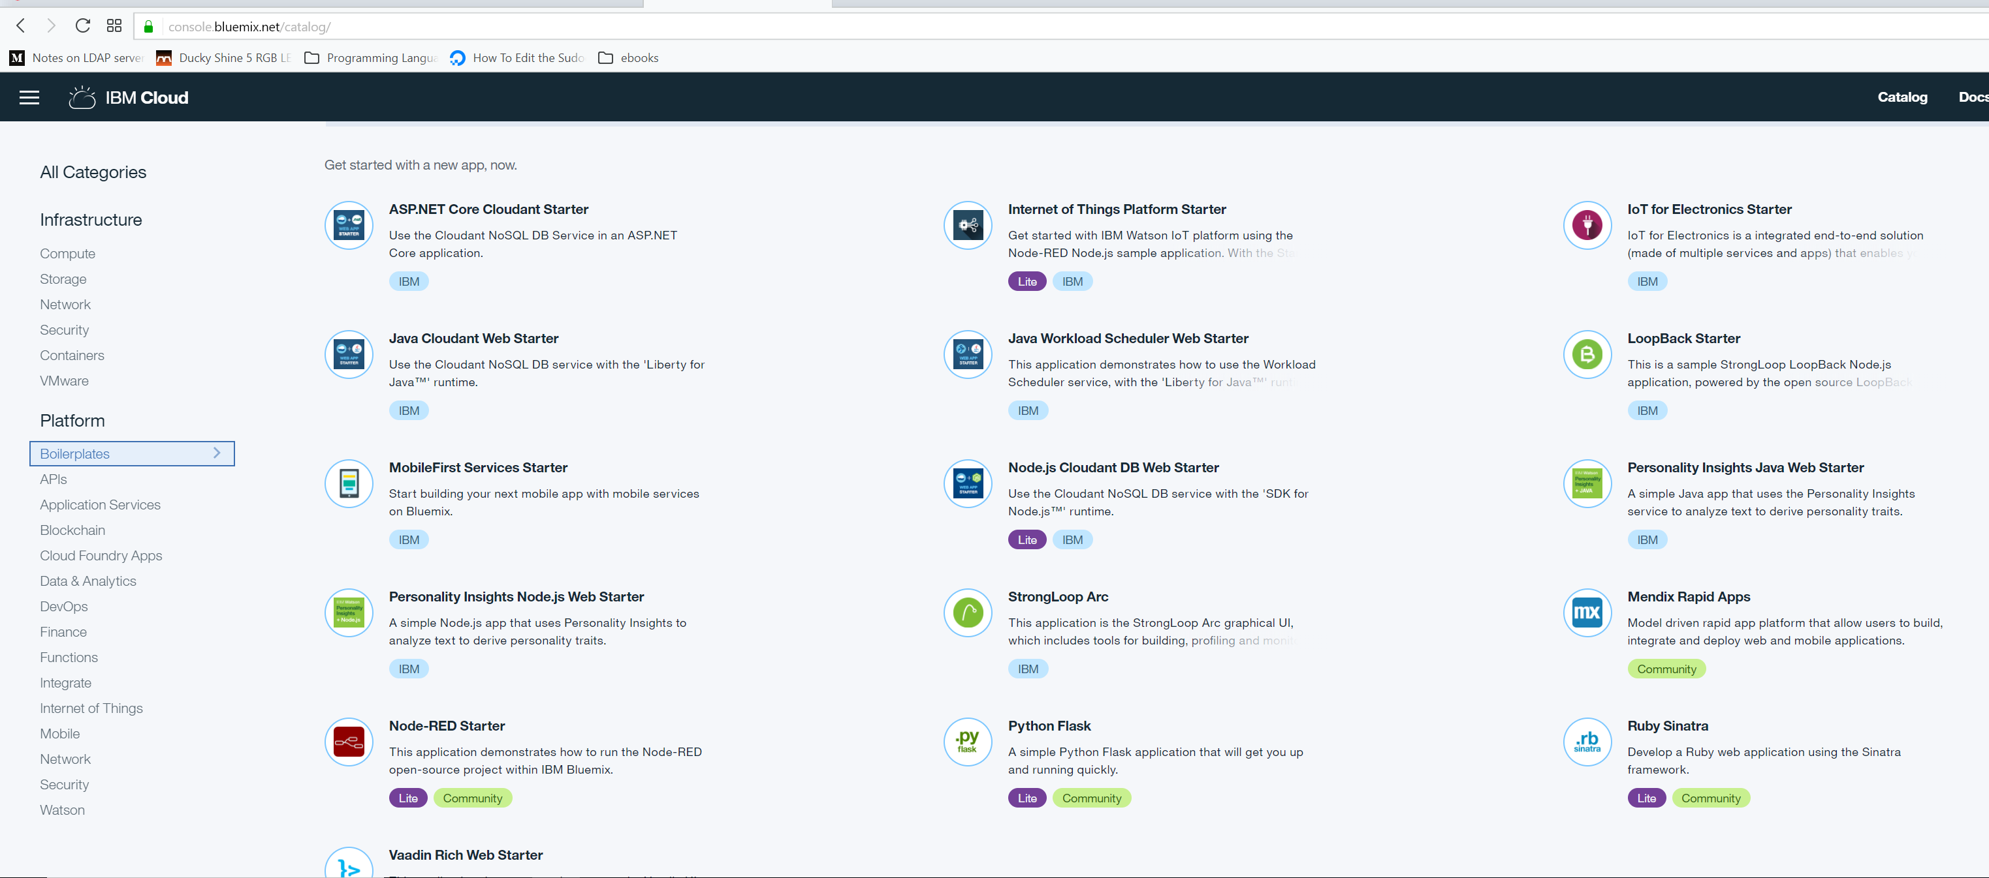
Boilerplates
Notes:
What are Boilerplates?

Slide 5
Getting Around the Dashboard

Slide 6
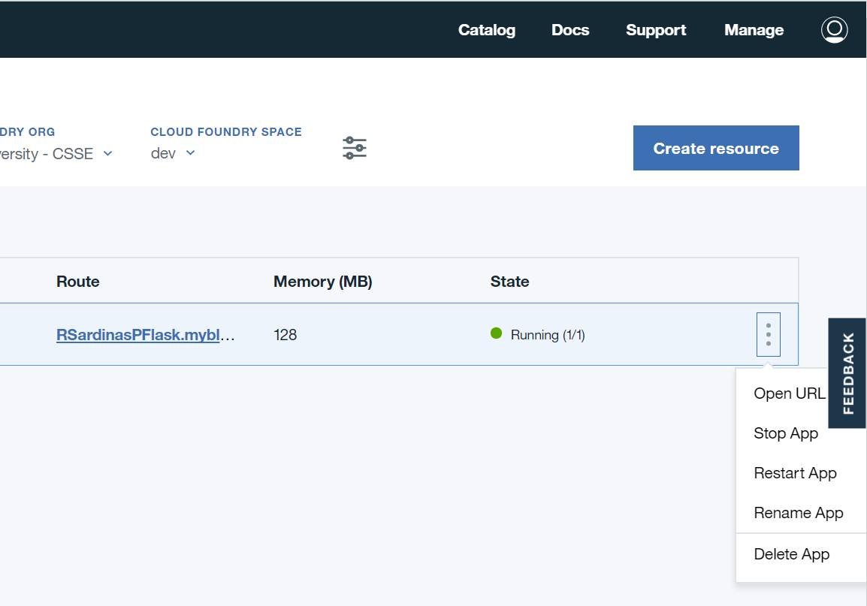
Application Options

Slide 7
Visit Running App on Web

Slide 8
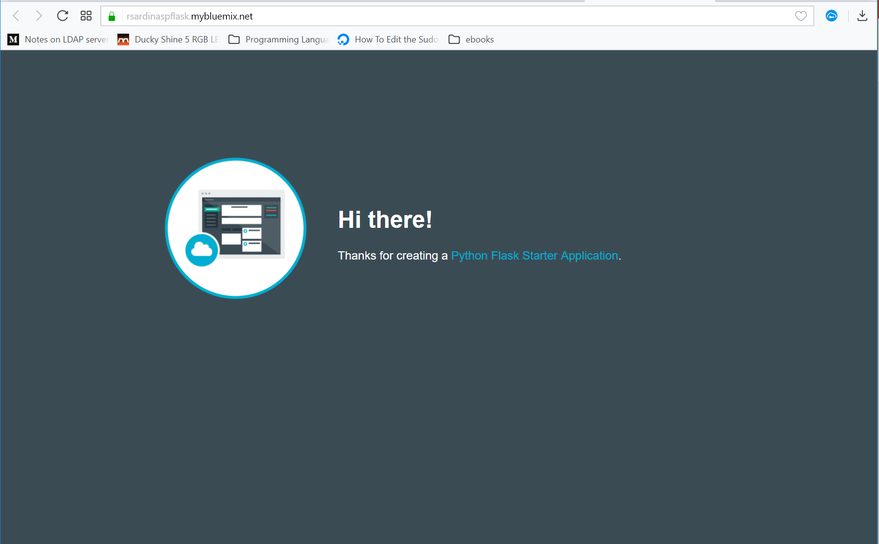
Running App

Slide 9
Modify App Options

Slide 10
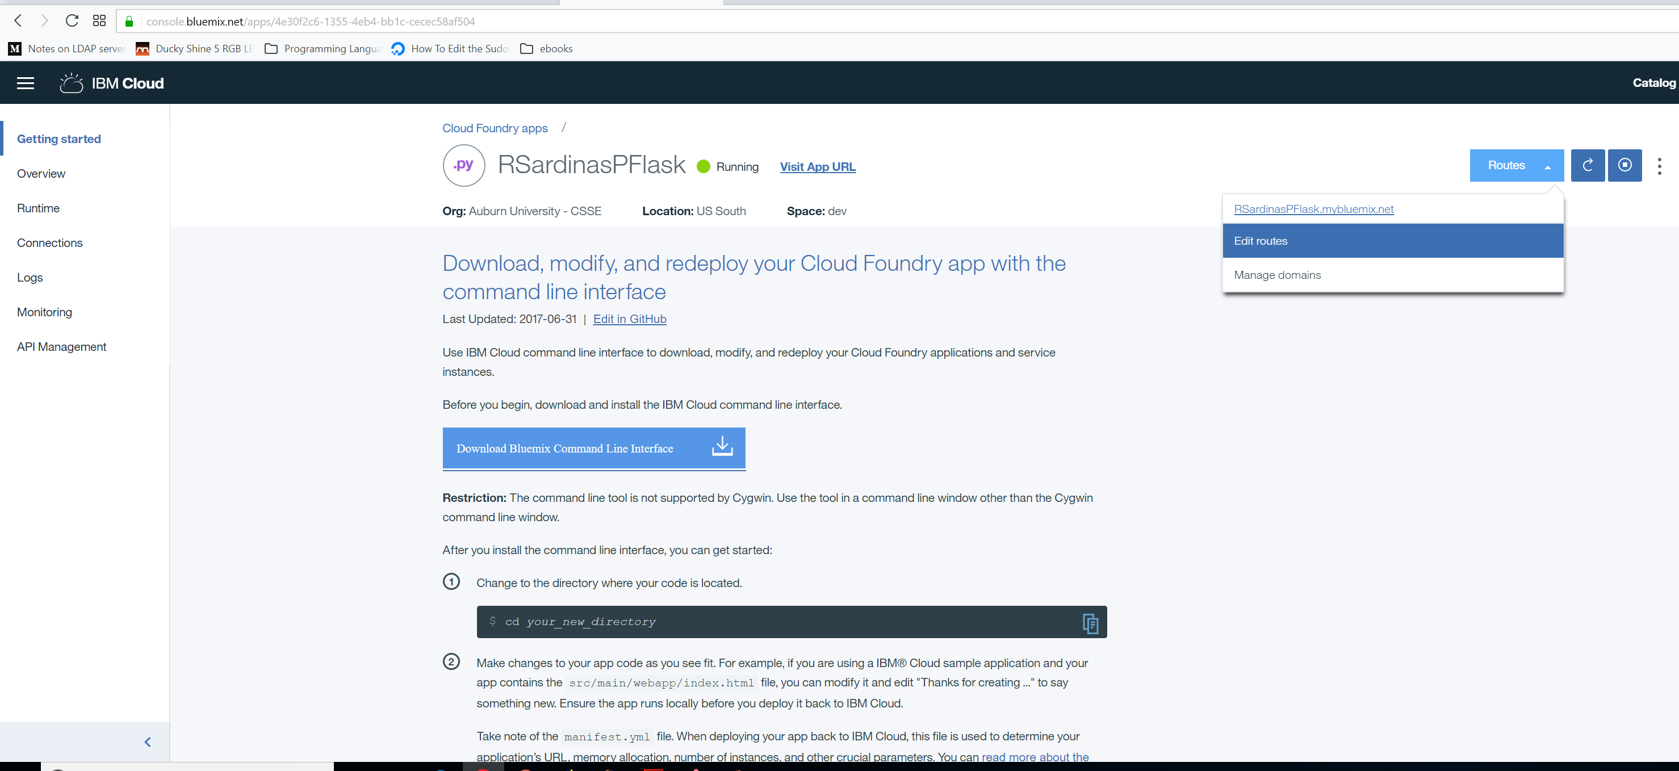
App Getting Started Page
Notes:
Point out Edit Routes (URL/Domain)
Point out menu items on left
Finally, mouse click and manage domains
Point out that many of the items we will discuss in the menus are cloud related topics we will cover in different chapters in the book

Slide 11
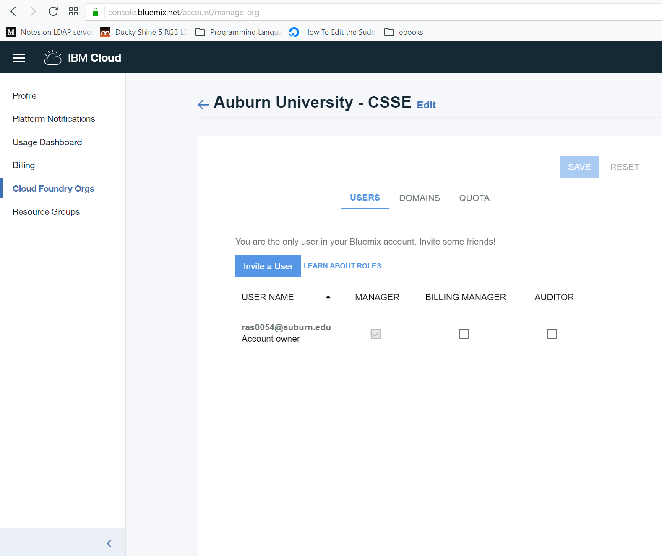
Manage App Use

Slide 12
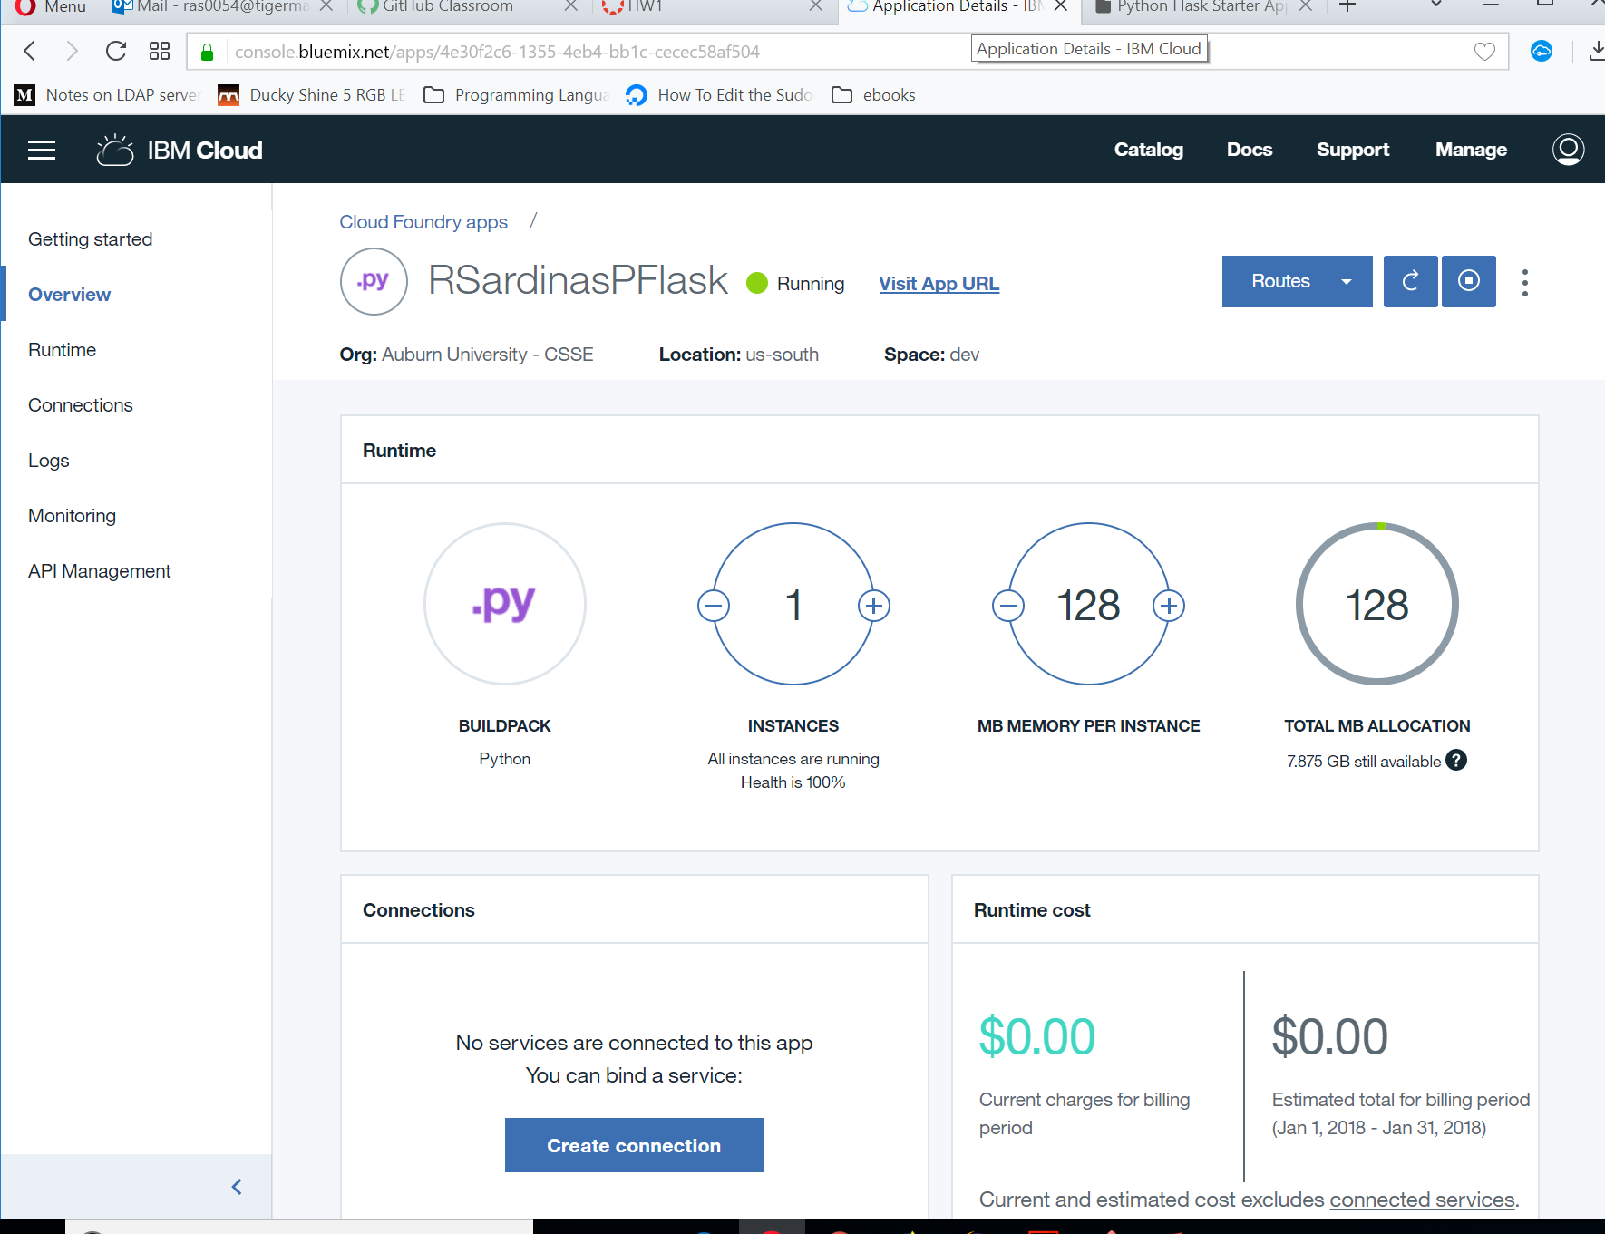
App Overview
Notes:
Question 1: What type of scaling would it be if we were to increase the instances count? – horizontal (scaling out)
Question 2: What type of scaling would it be if we were to increase the MB per instance count? –vertical (scaling up)

Slide 13
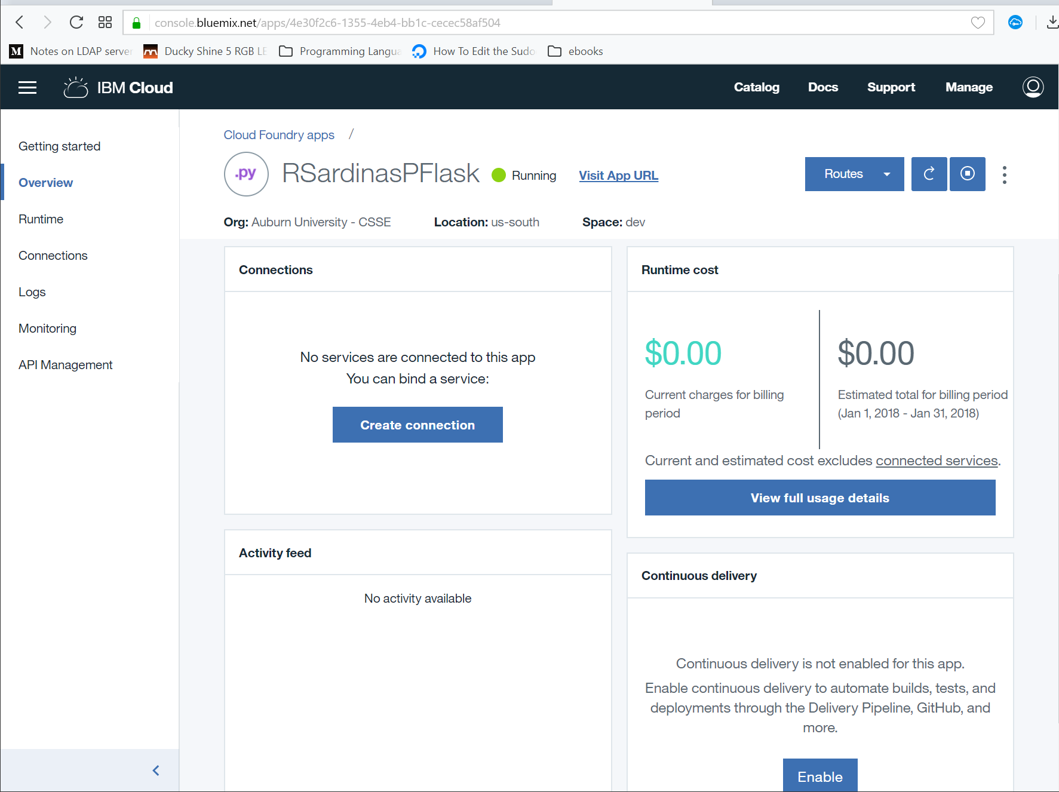
App Overview cont…
Notes:
We’ll come back to this

Slide 14
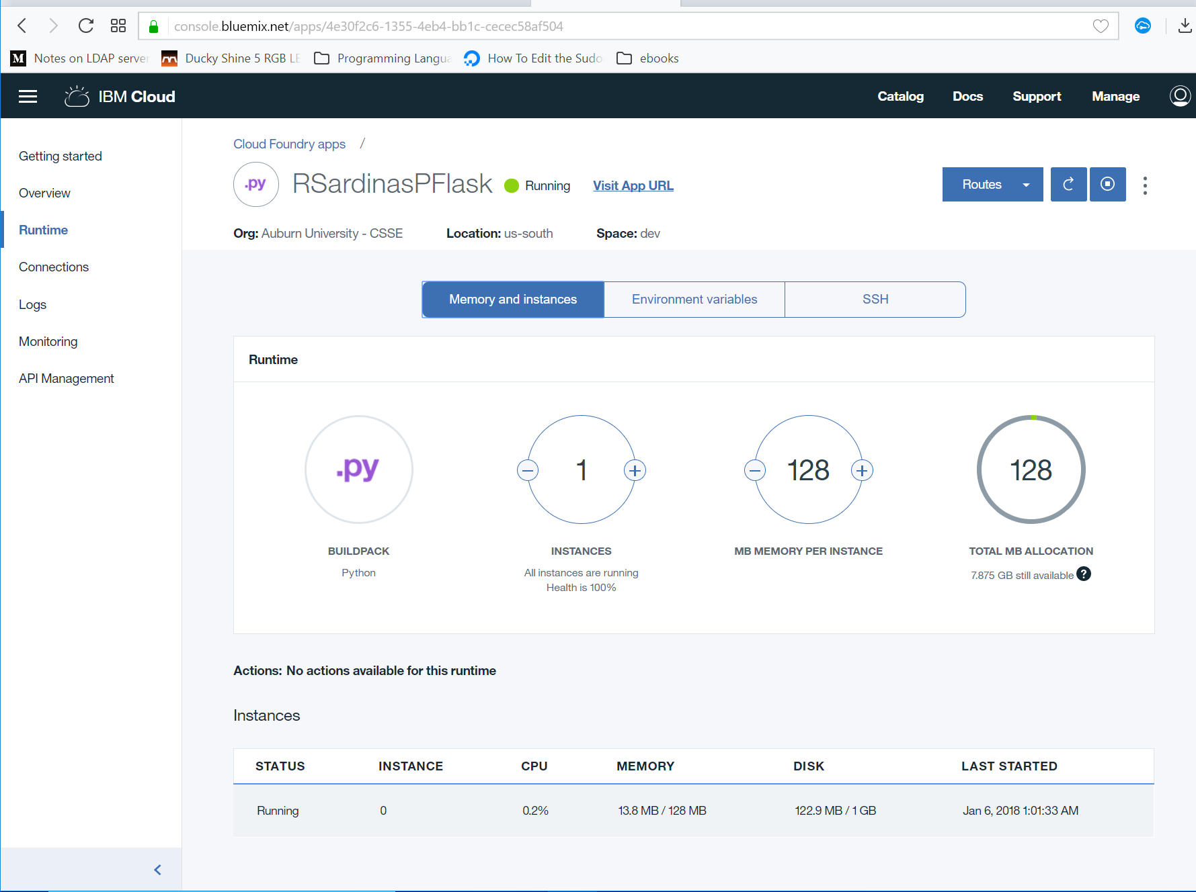
Real-time Information

Slide 15
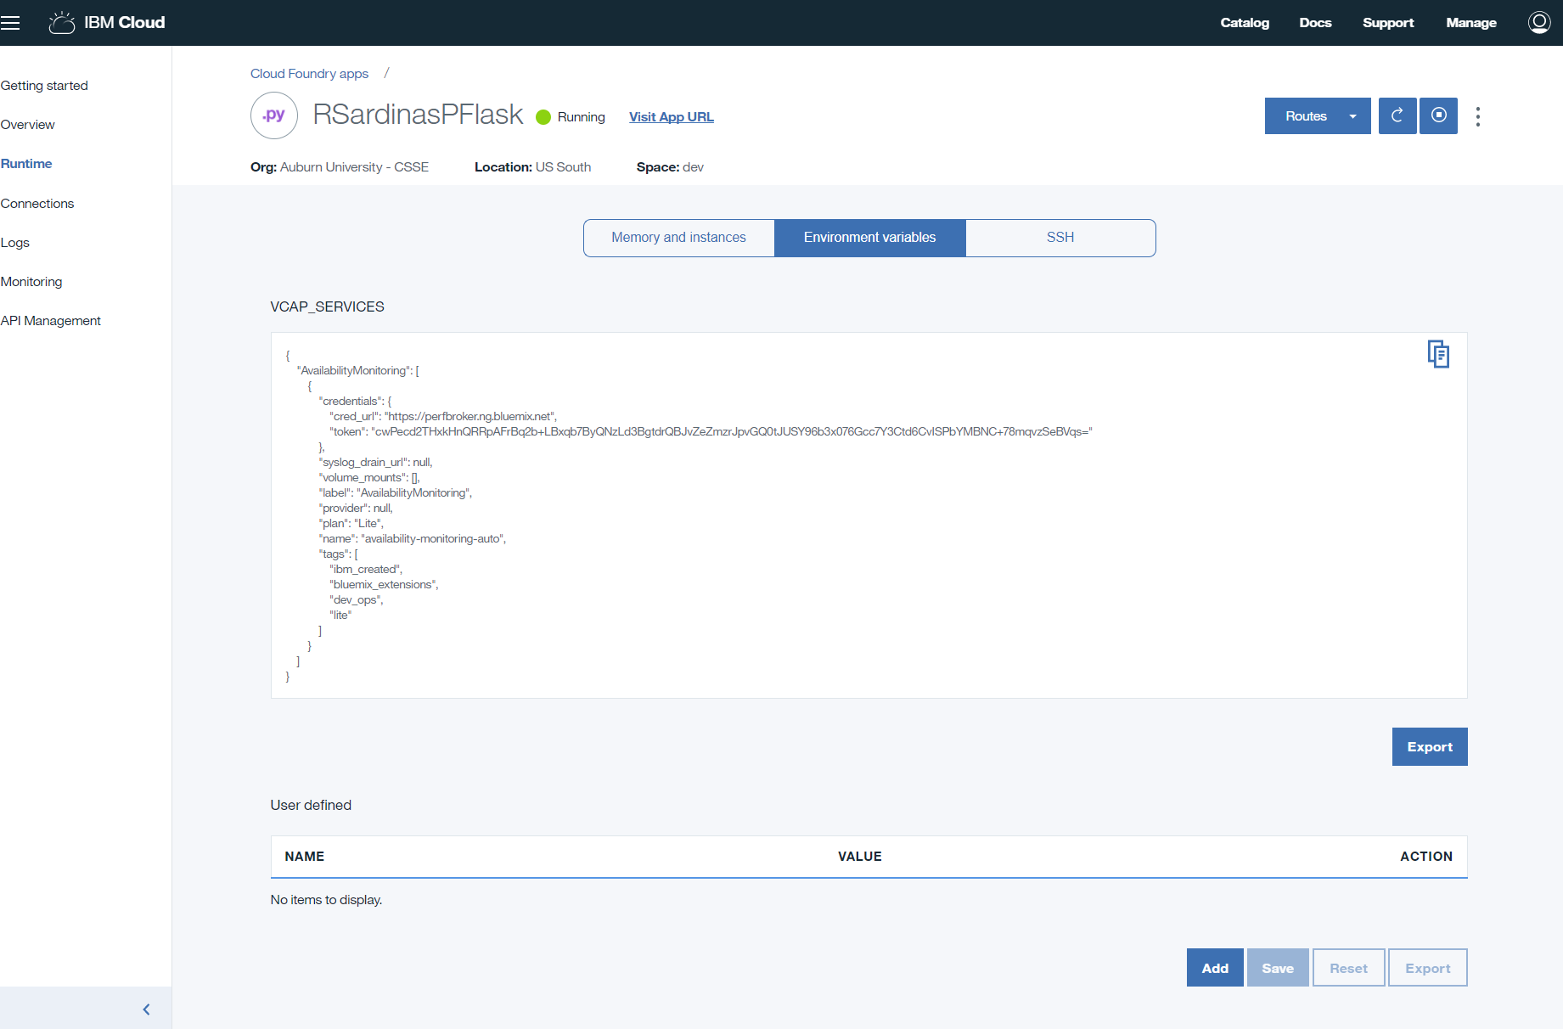
Service Credentials, etc…
Notes:
Note: I added this AFTER adding the toolchain which added services to this app.

Slide 16
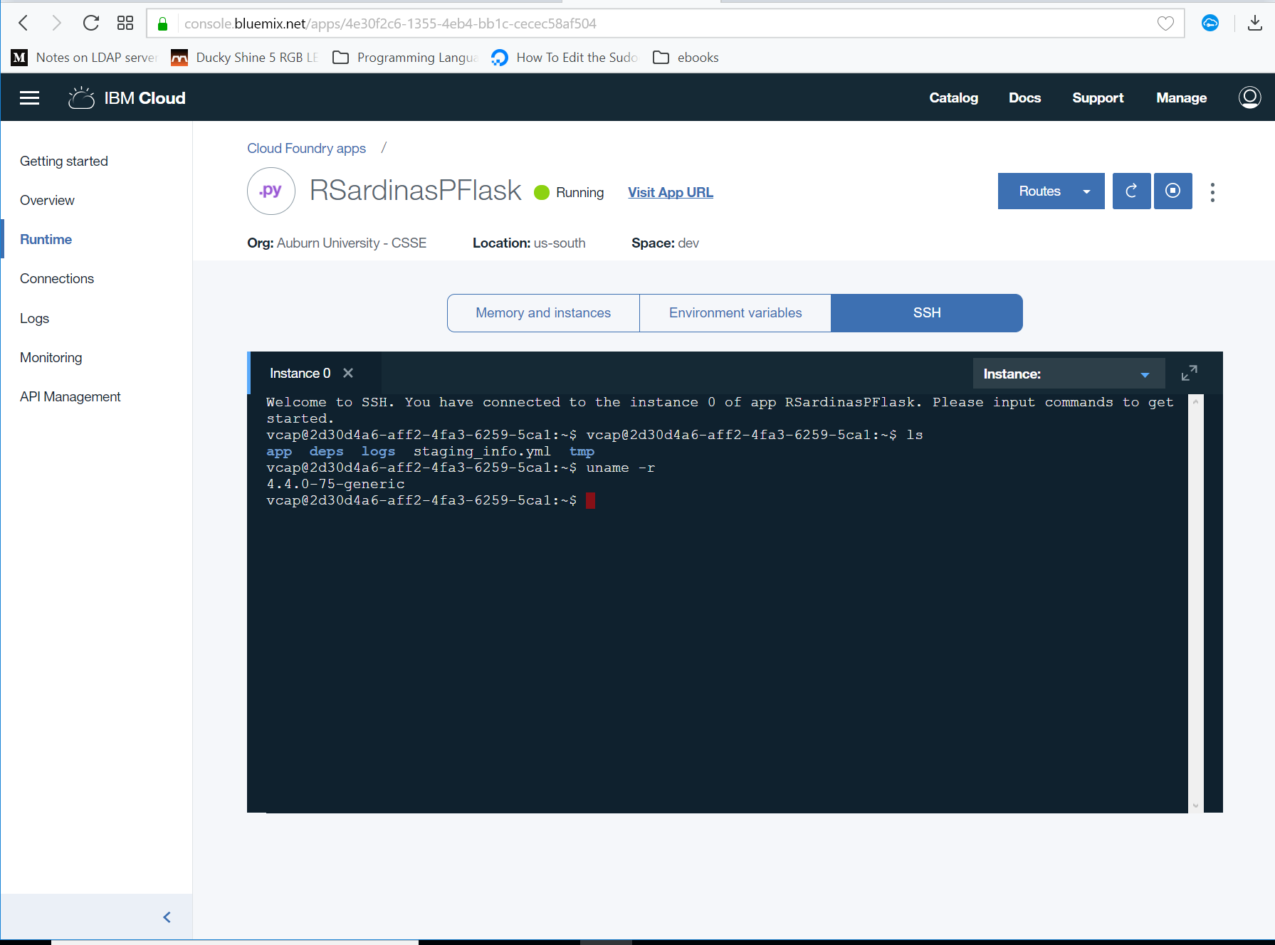
Directly issuing commands

Slide 17
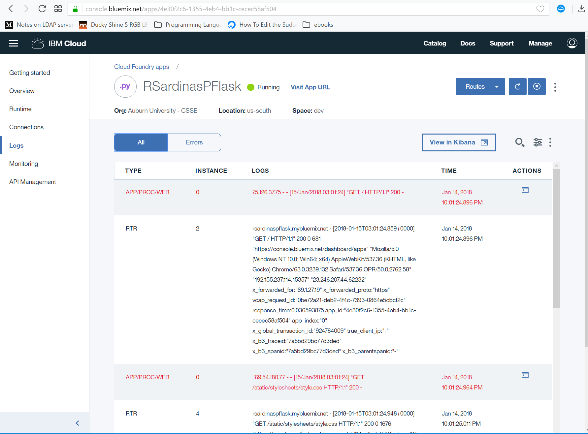
Logs

Slide 18
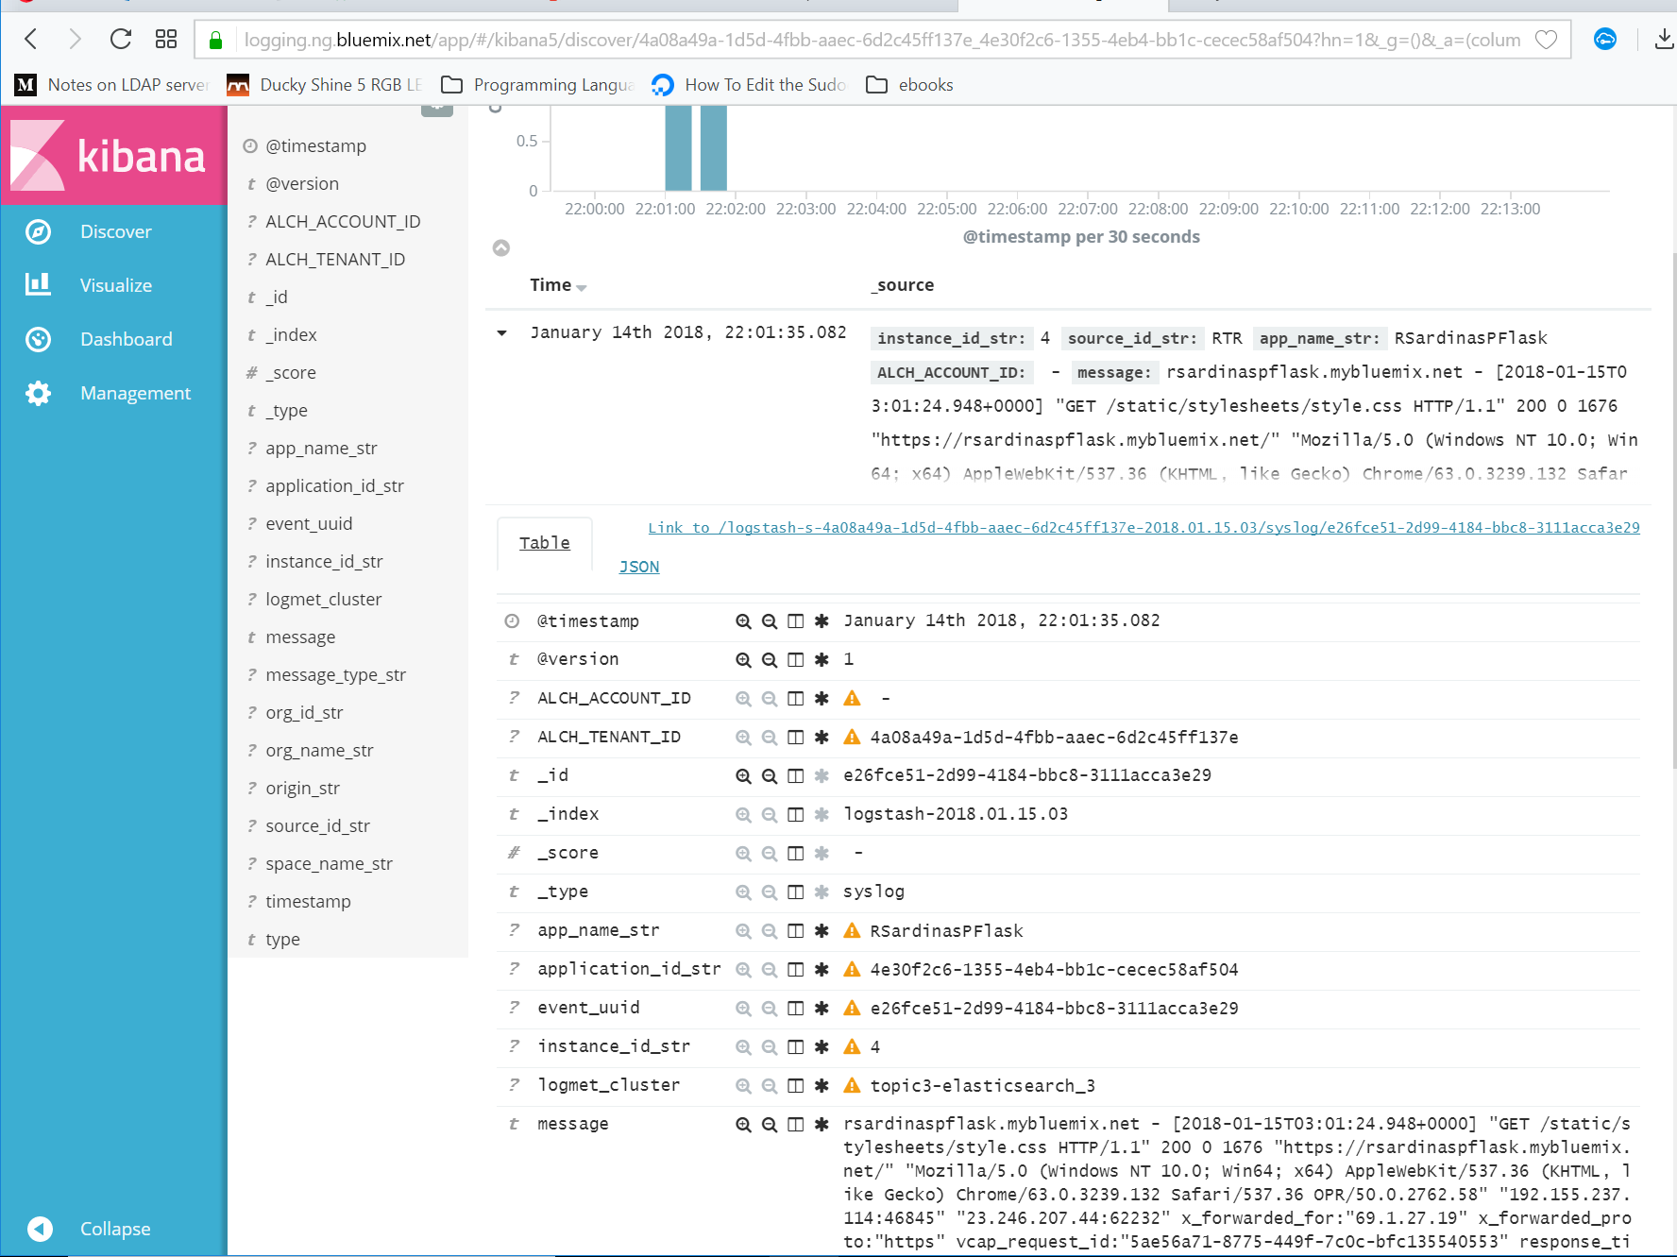
Elastic Search + Kibana
Notes:
https://www.elastic.co/community/security
Elastic Search Vulnerabilities

Slide 19
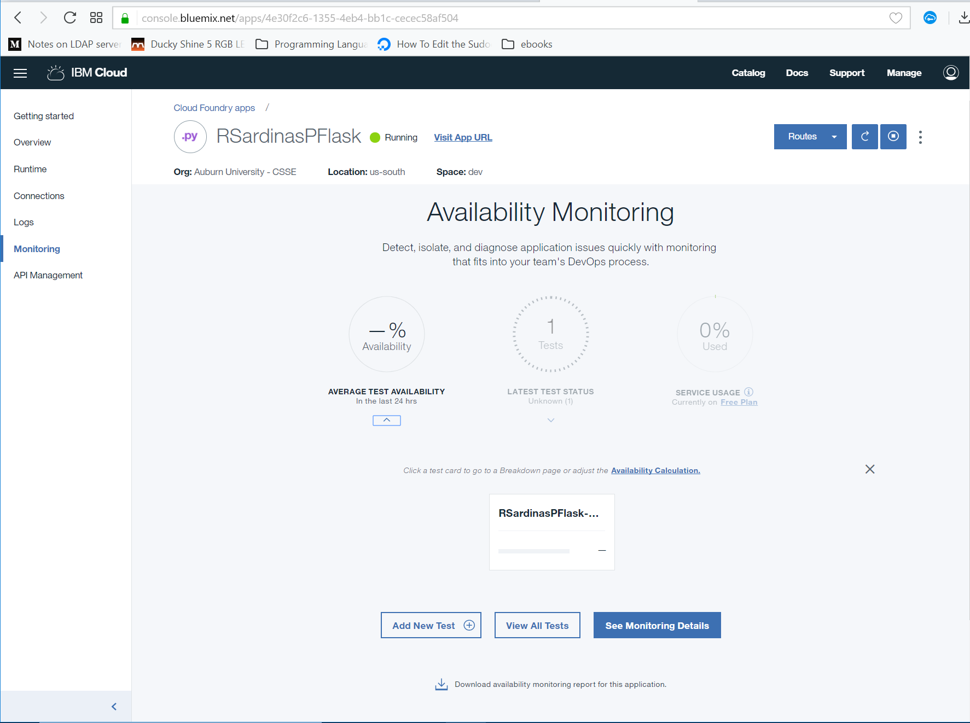
Availability Tests / Monitoring

Slide 20
Continuous Delivery
Notes:
Explain what this is

Slide 21
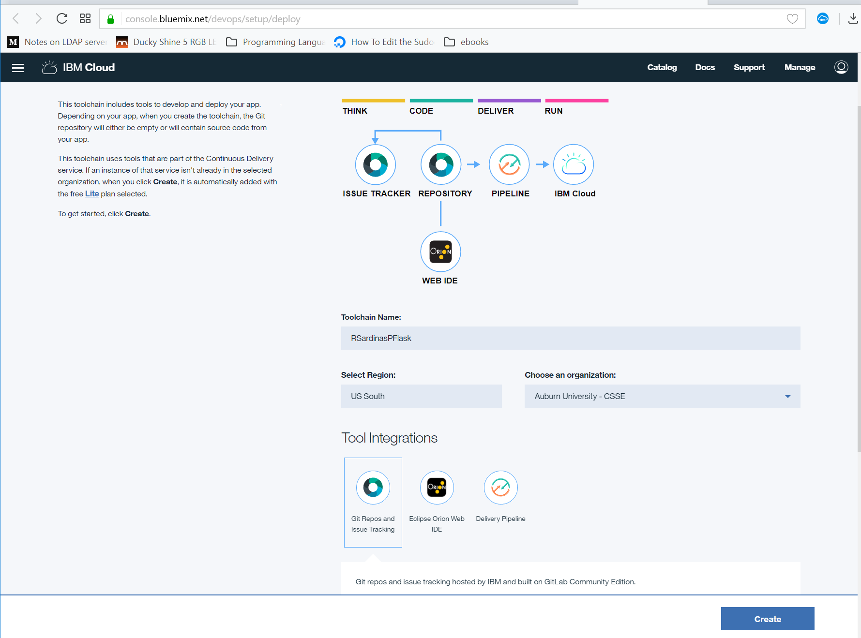
Continuous Delivery

Slide 22
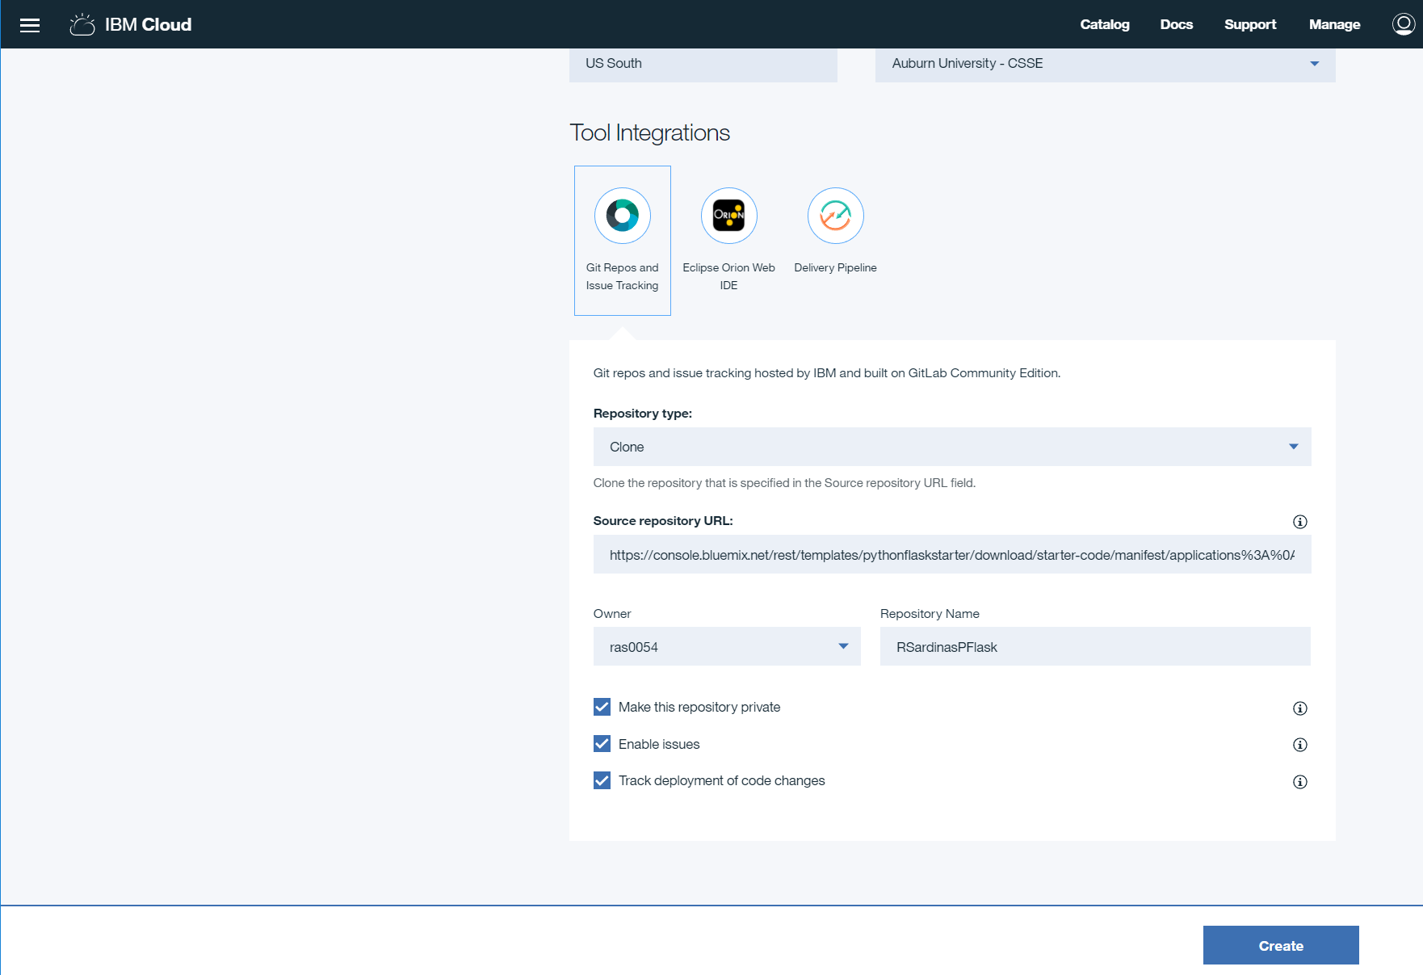
CD – Default Repo

Slide 23
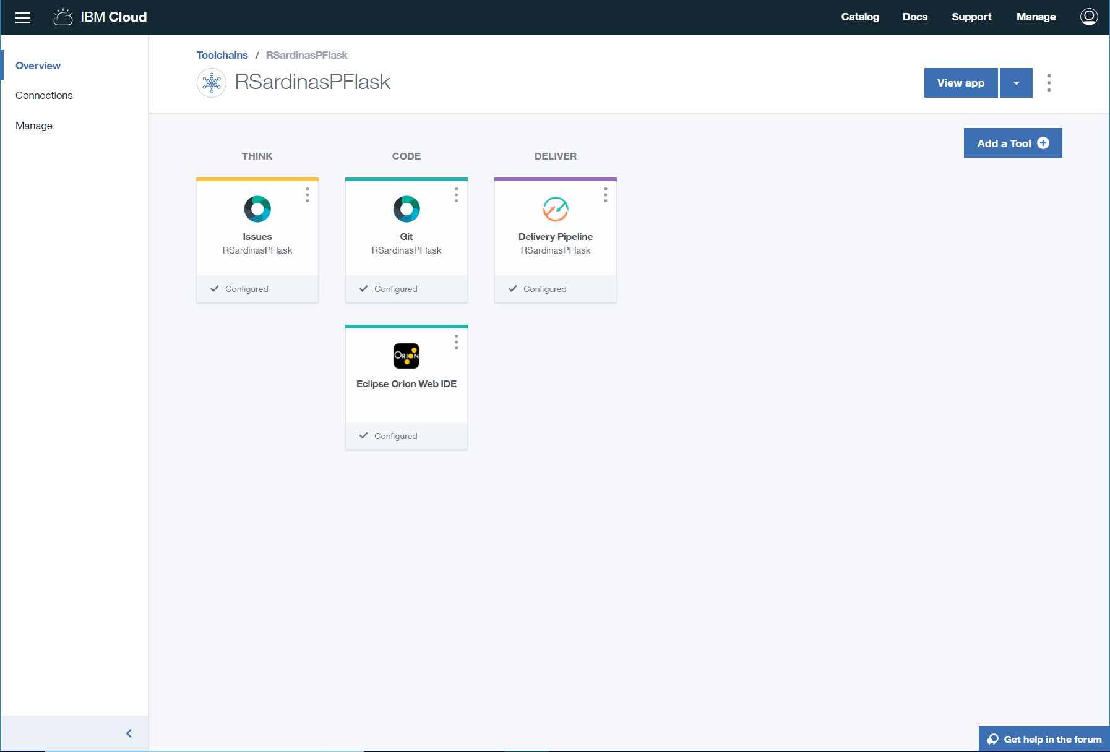
Continuous Delivery Other Default Tools

Slide 24
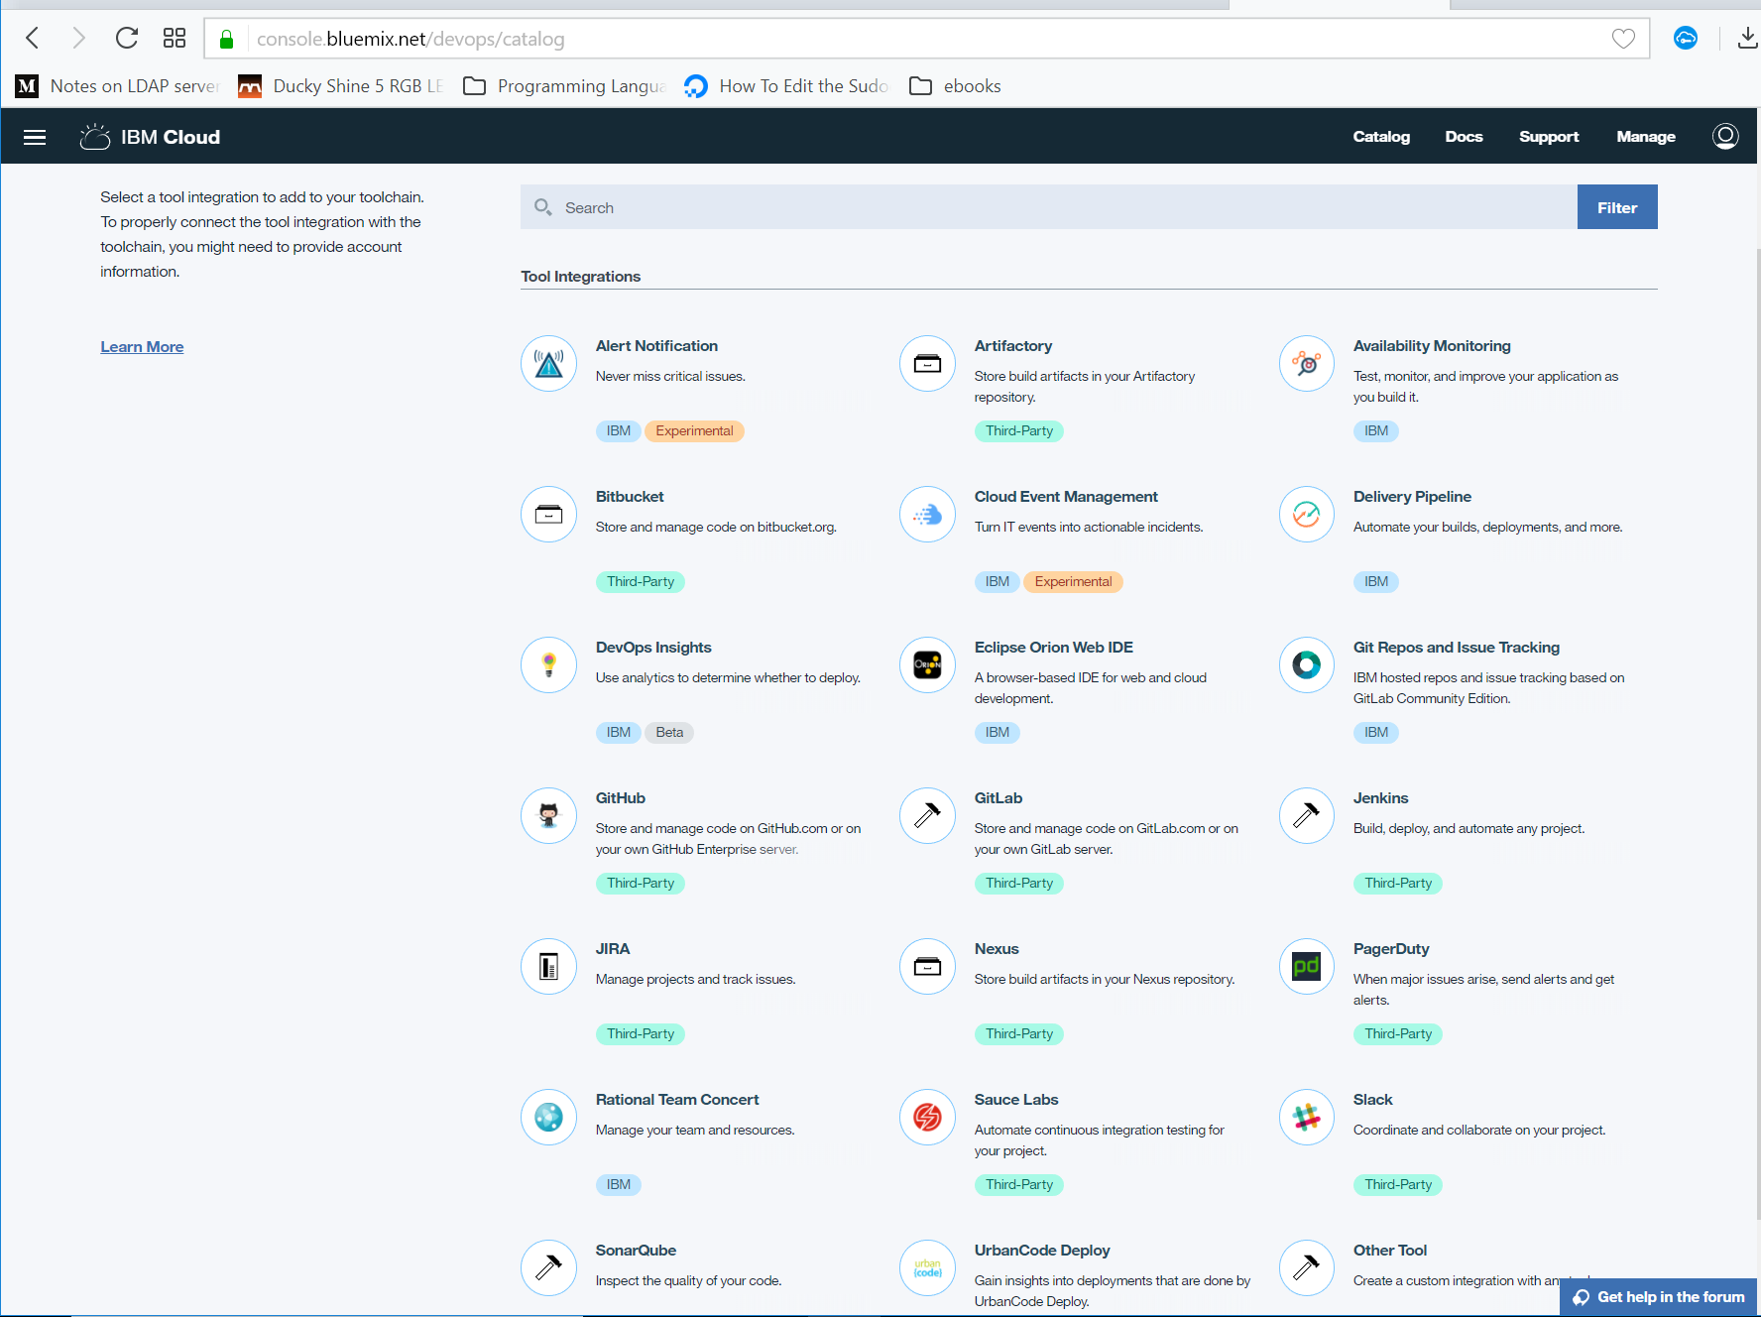
Continuous Delivery Other tools options

Slide 25
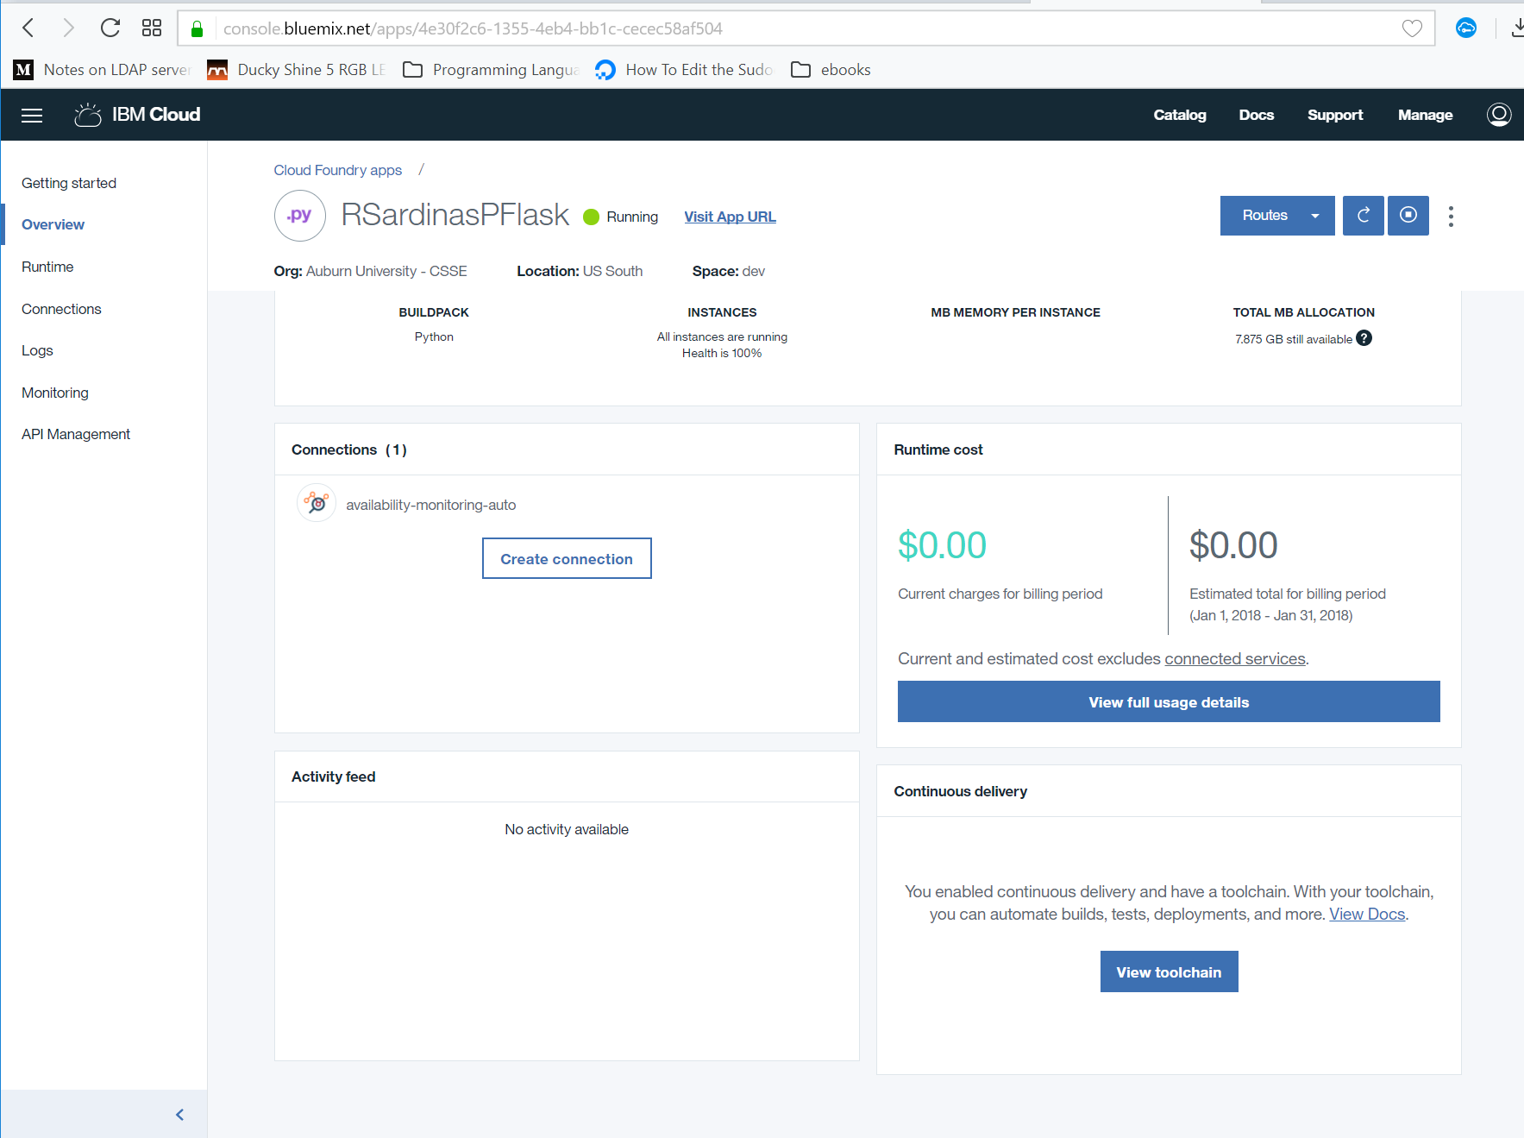
Customizing Continuous Delivery Toolchain

Slide 26
Continuous Delivery Other Default Tools
Options

Slide 27
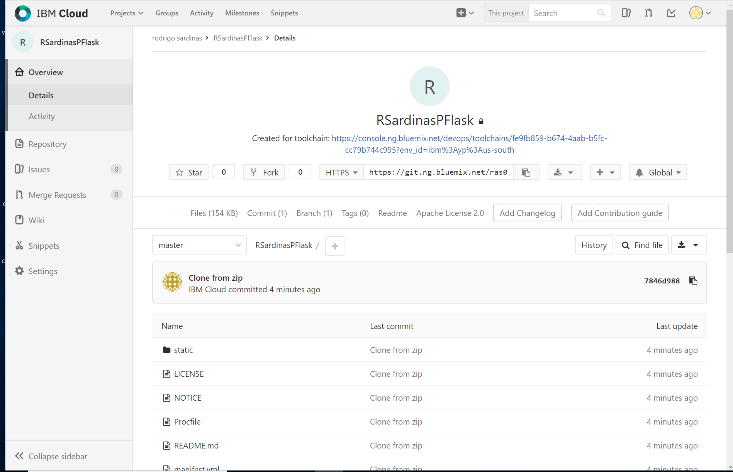
IBM Cloud Private Repo
Notes:
Just a git repo
Wiki, Issues tracker, etc…

Slide 28
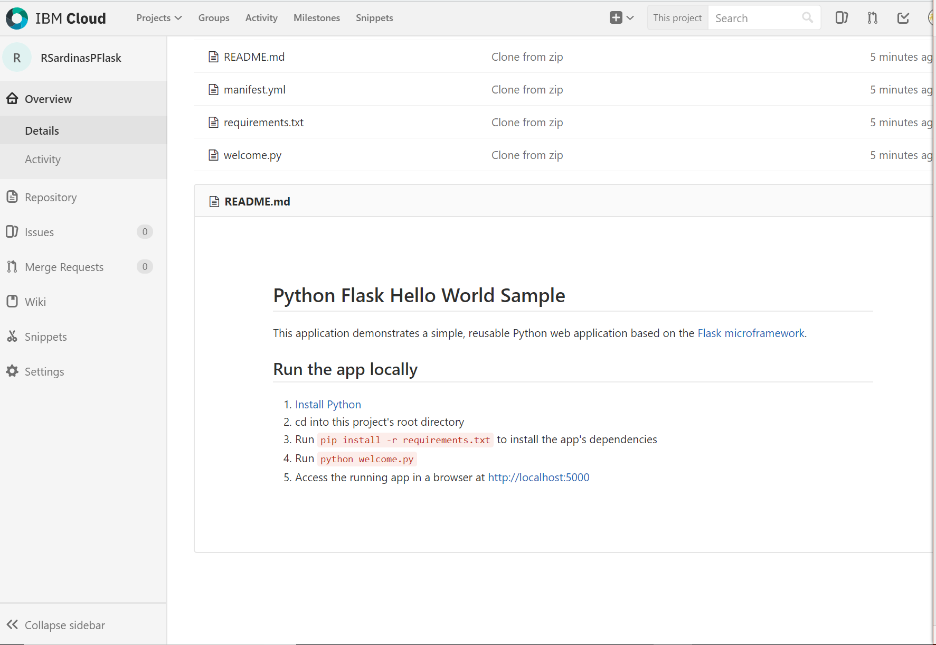
IBM Cloud Private Repo
Notes:
Just a git repo
Wiki, Issues tracker, etc…

Slide 29
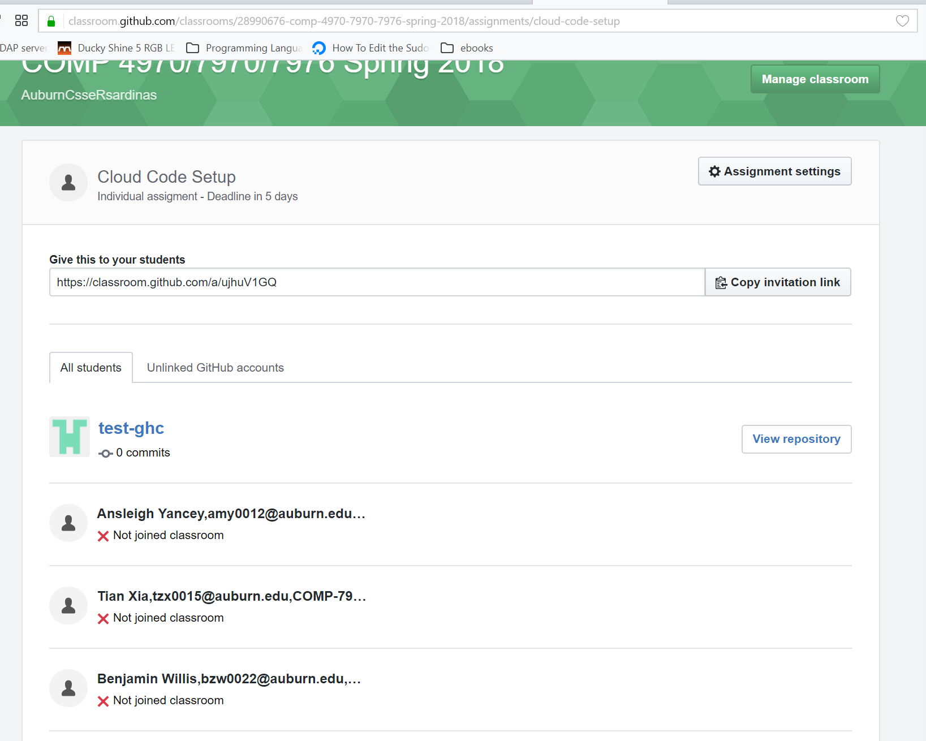
My View (Github Classroom)

Slide 30
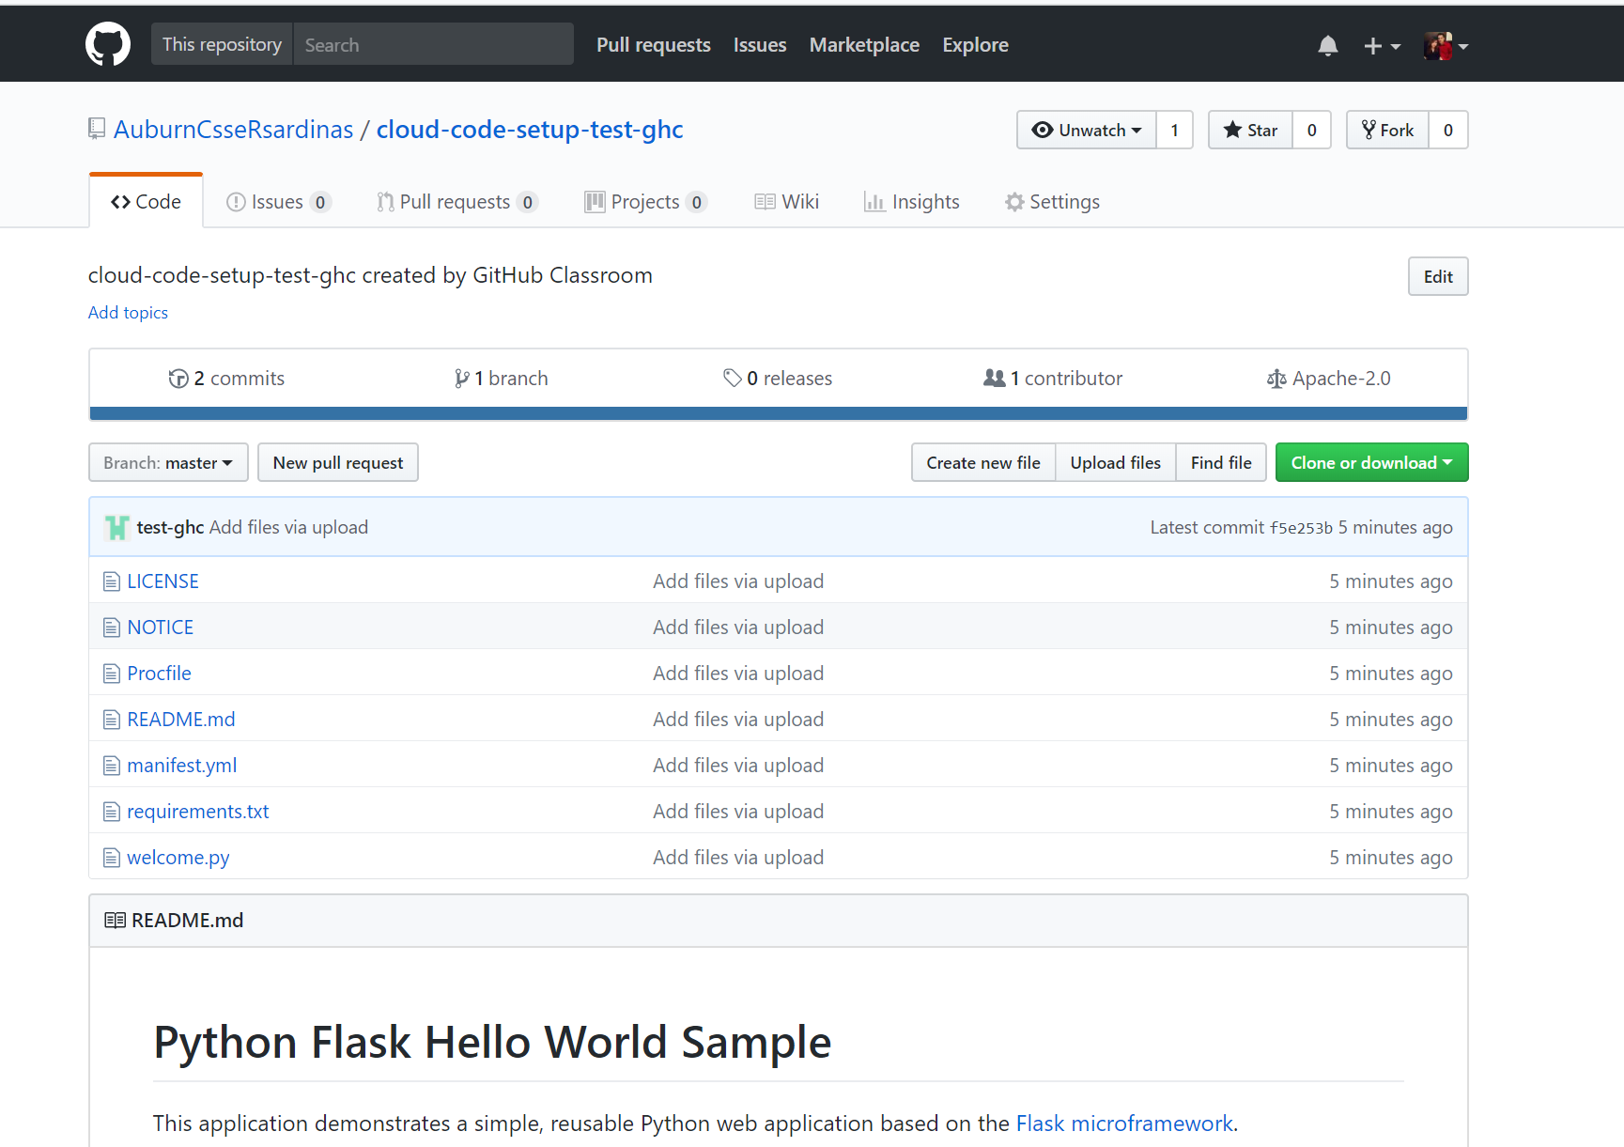
Your Repo (my view again)

Slide 31
Continuous Delivery Other Default Tools
Notes:
Online Eclipse

Slide 32
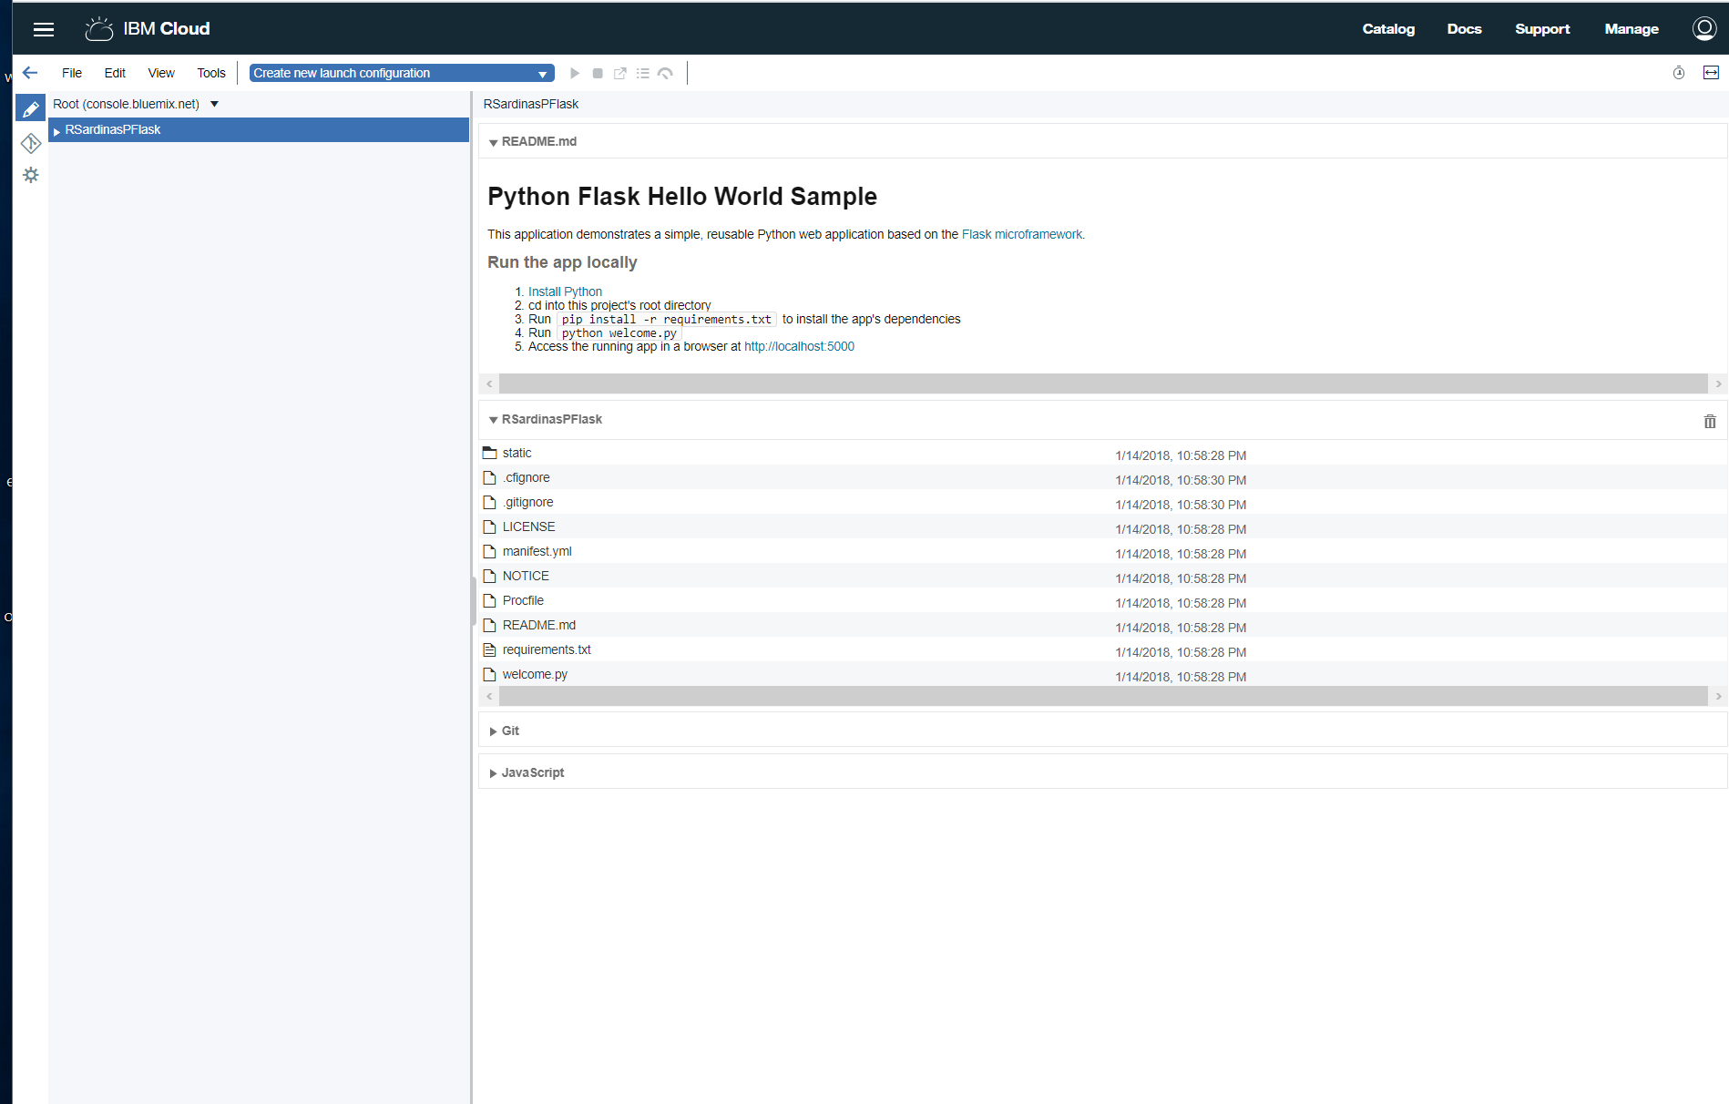
Orion (online eclipse)

Slide 33
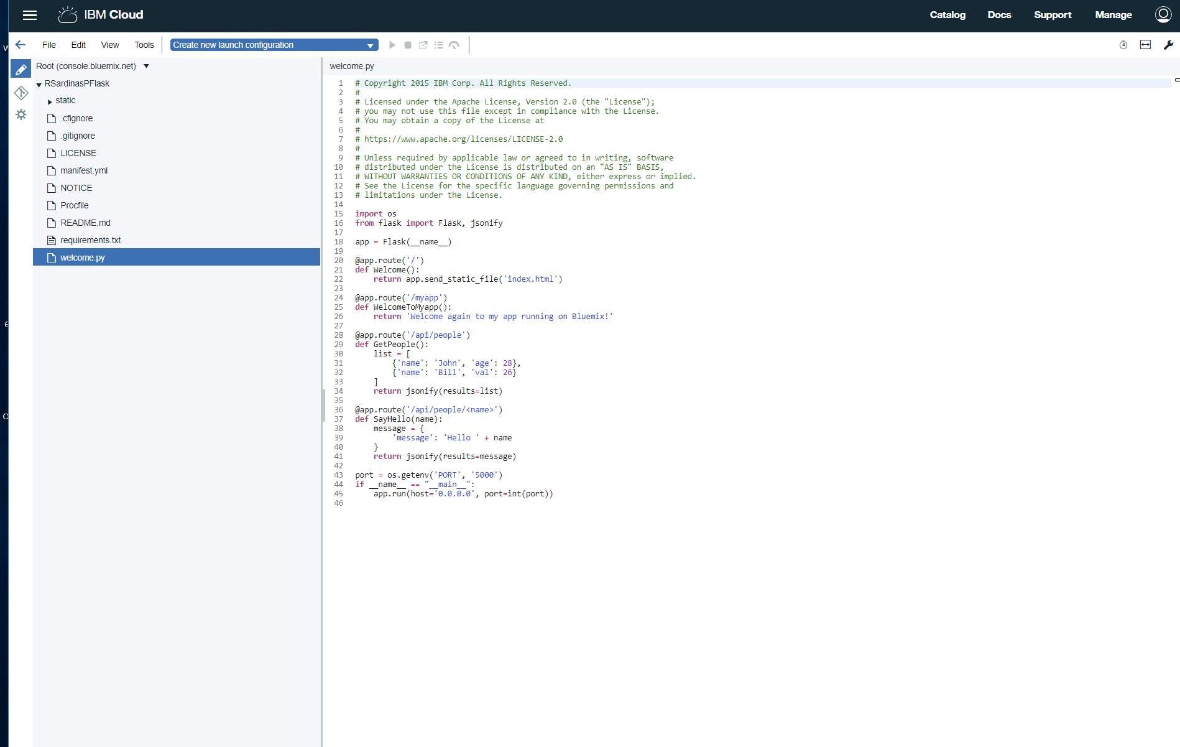
Orion (Online Eclipse)

Slide 34
Continuous Delivery Other Default Tools

Slide 35
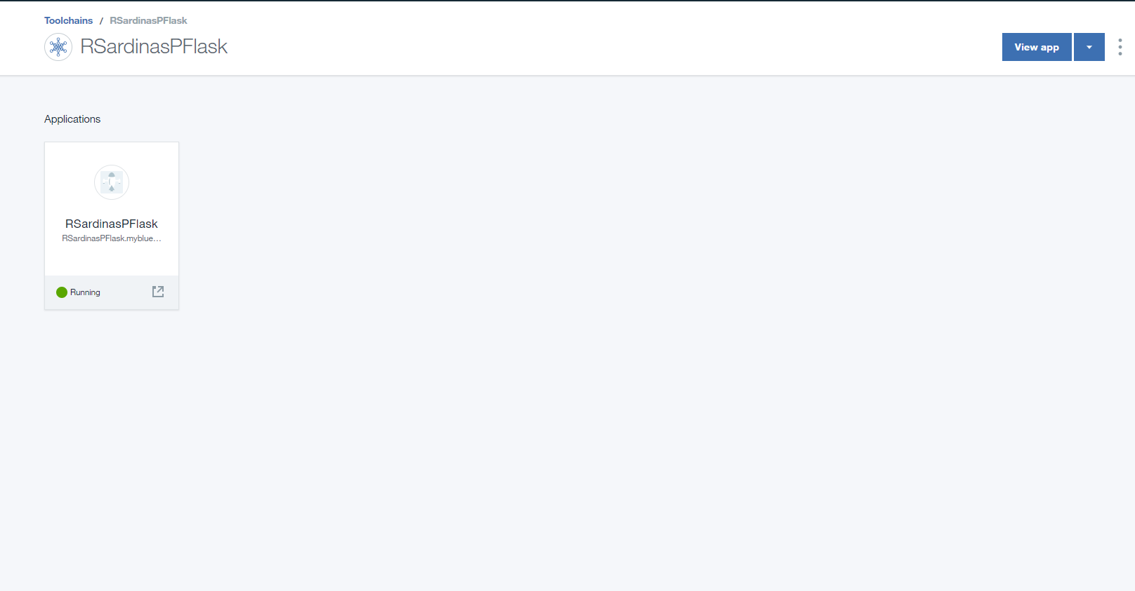
Toolchain Associated App

Slide 36
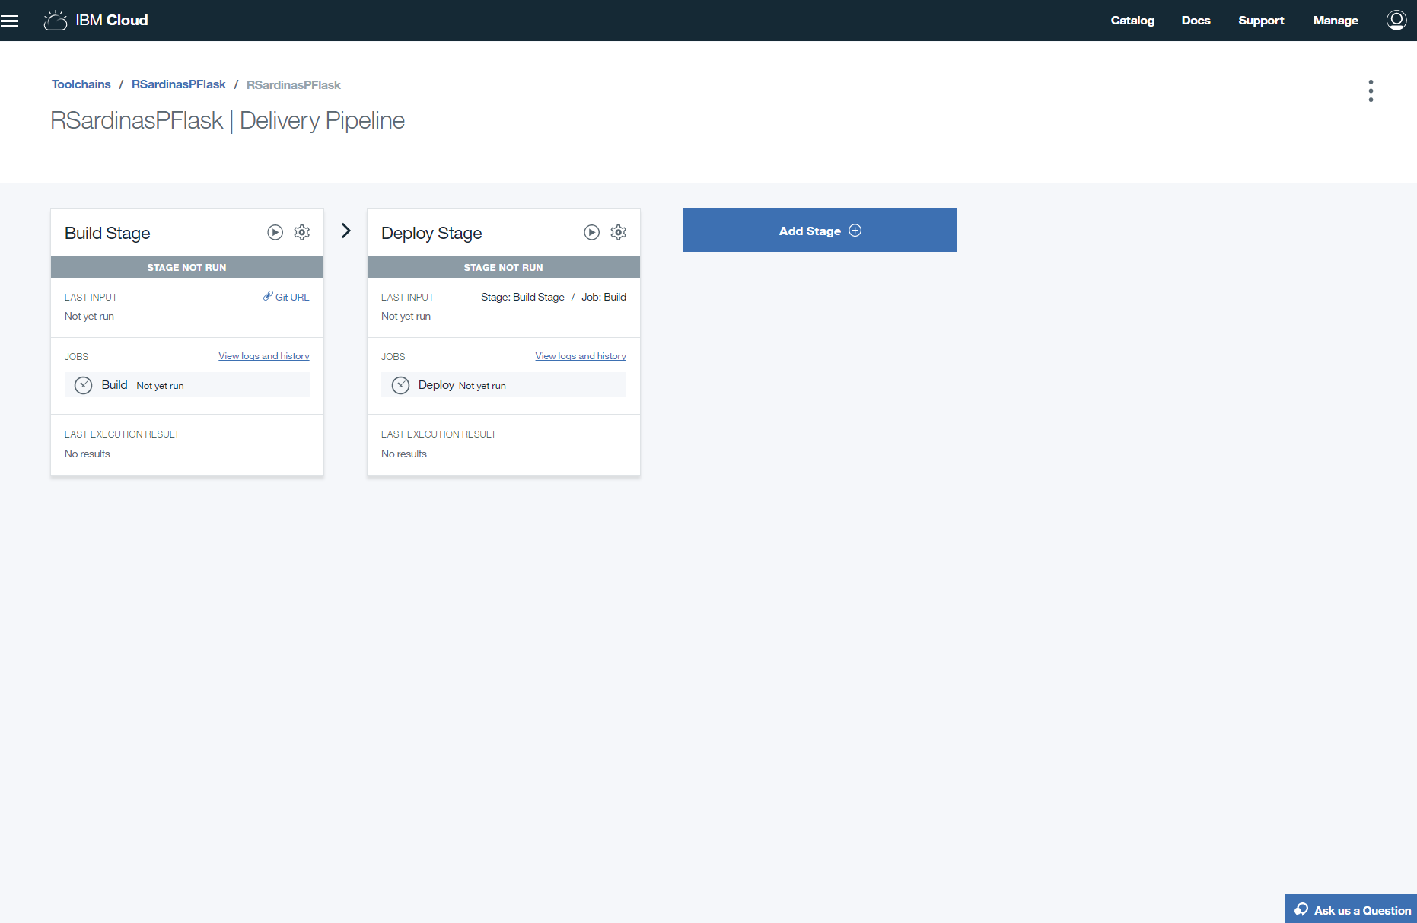
Configuring Delivery Pipeline
Notes:
Explain stages
Discuss Dev/Ops (dev/test/prod stages) and how this might relate

Slide 37
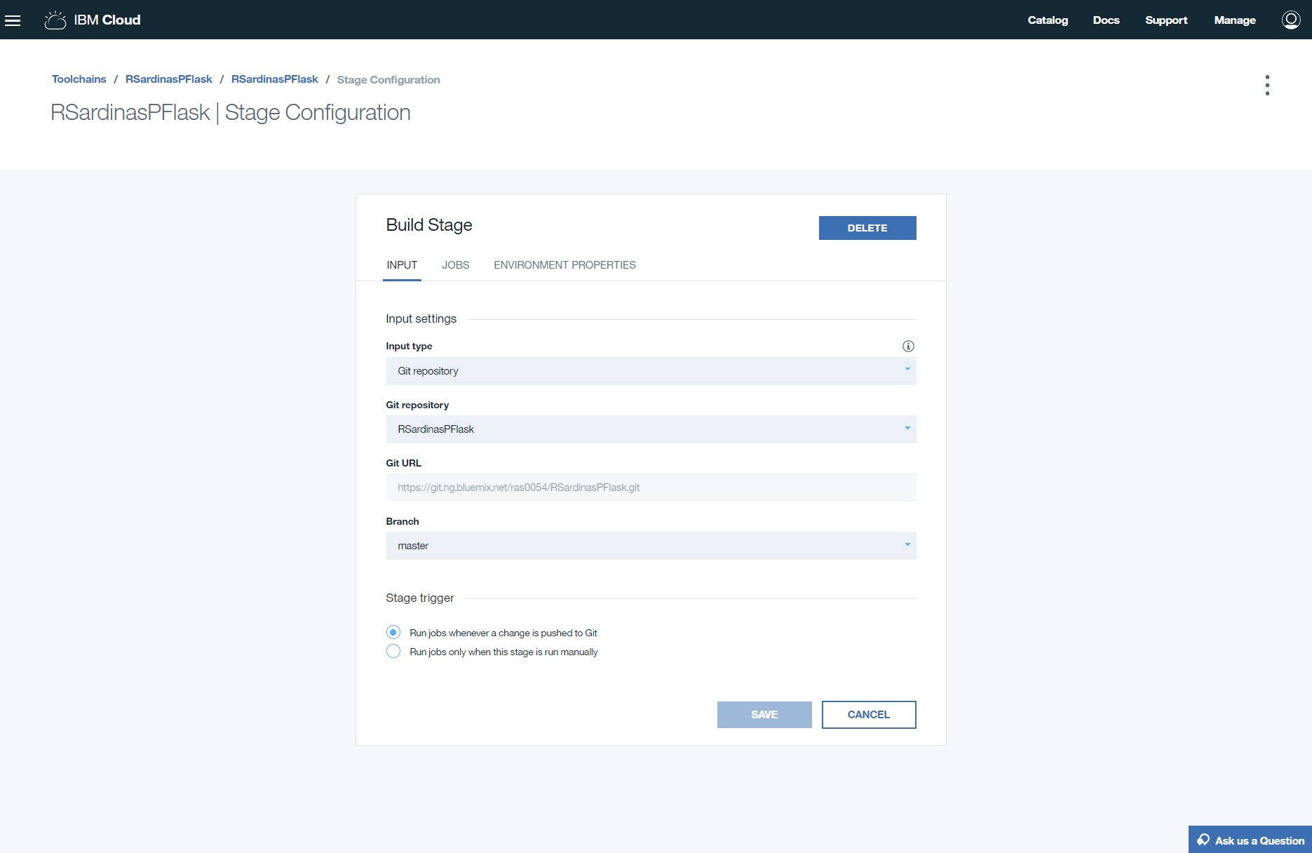
Configuring Delivery Pipeline Stage 1 (Build)

Slide 38
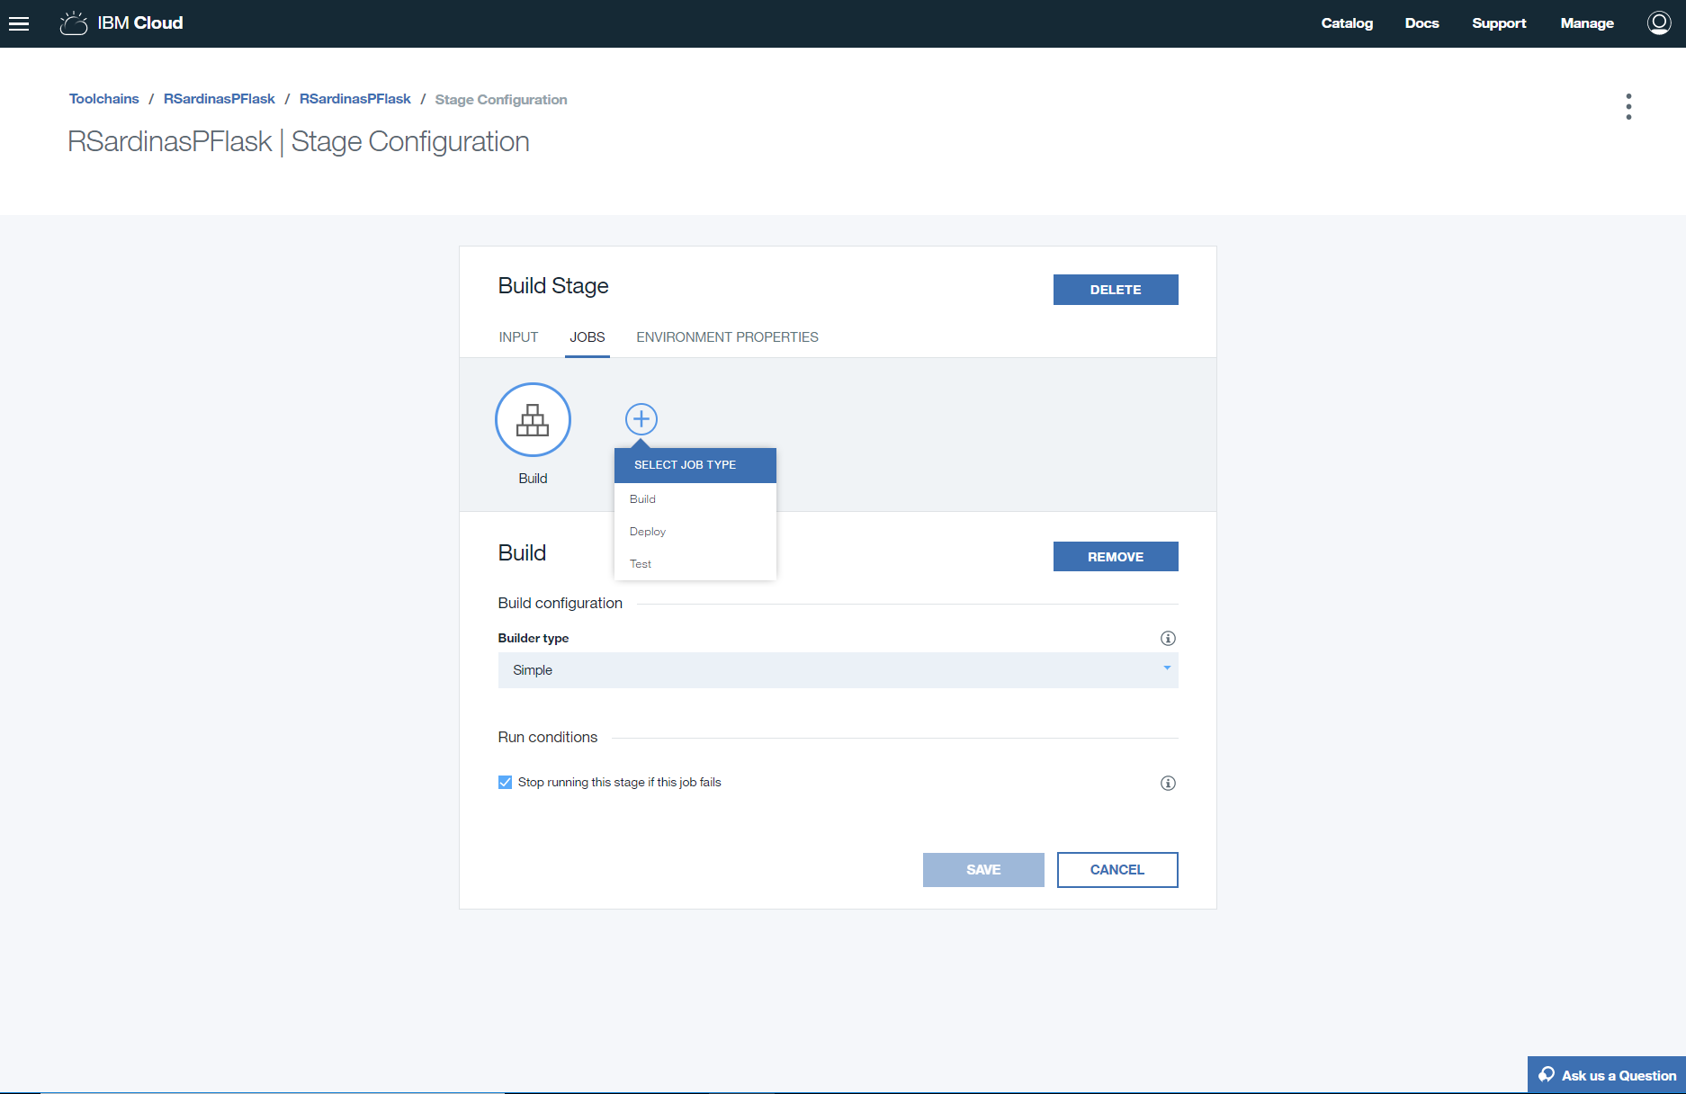
Configuring Delivery Pipeline Other Options

Slide 39
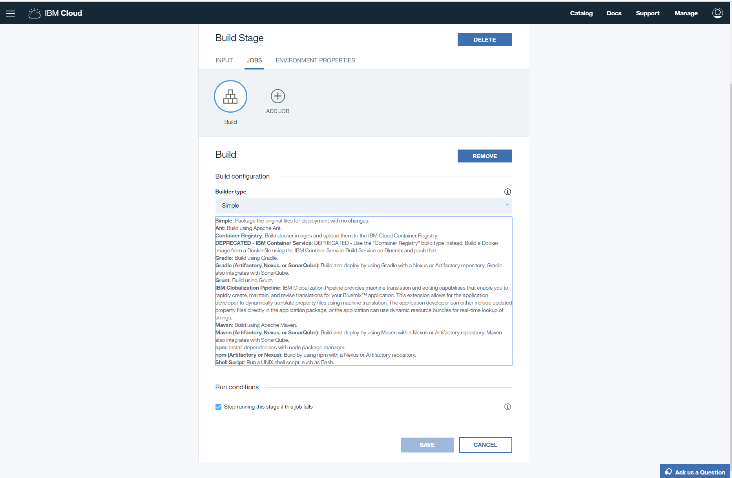
Configure Delivery Pipeline Build Options

Slide 40
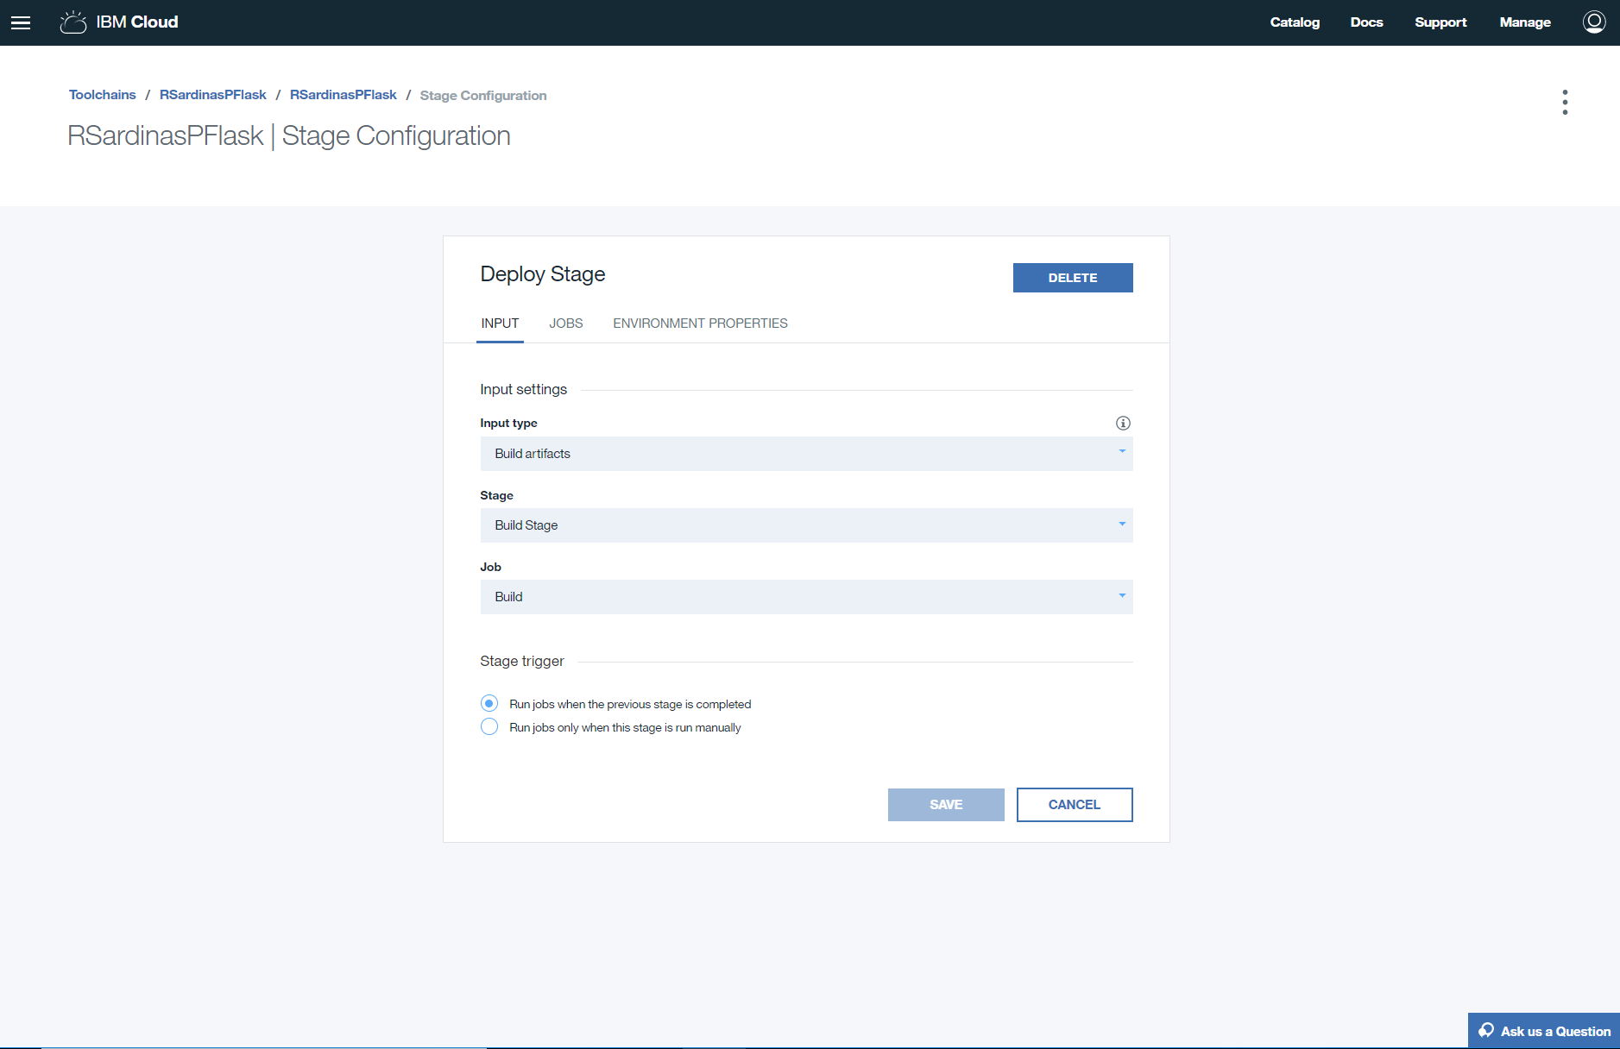
Configure Delivery Pipeline Deploy Stage

Slide 41
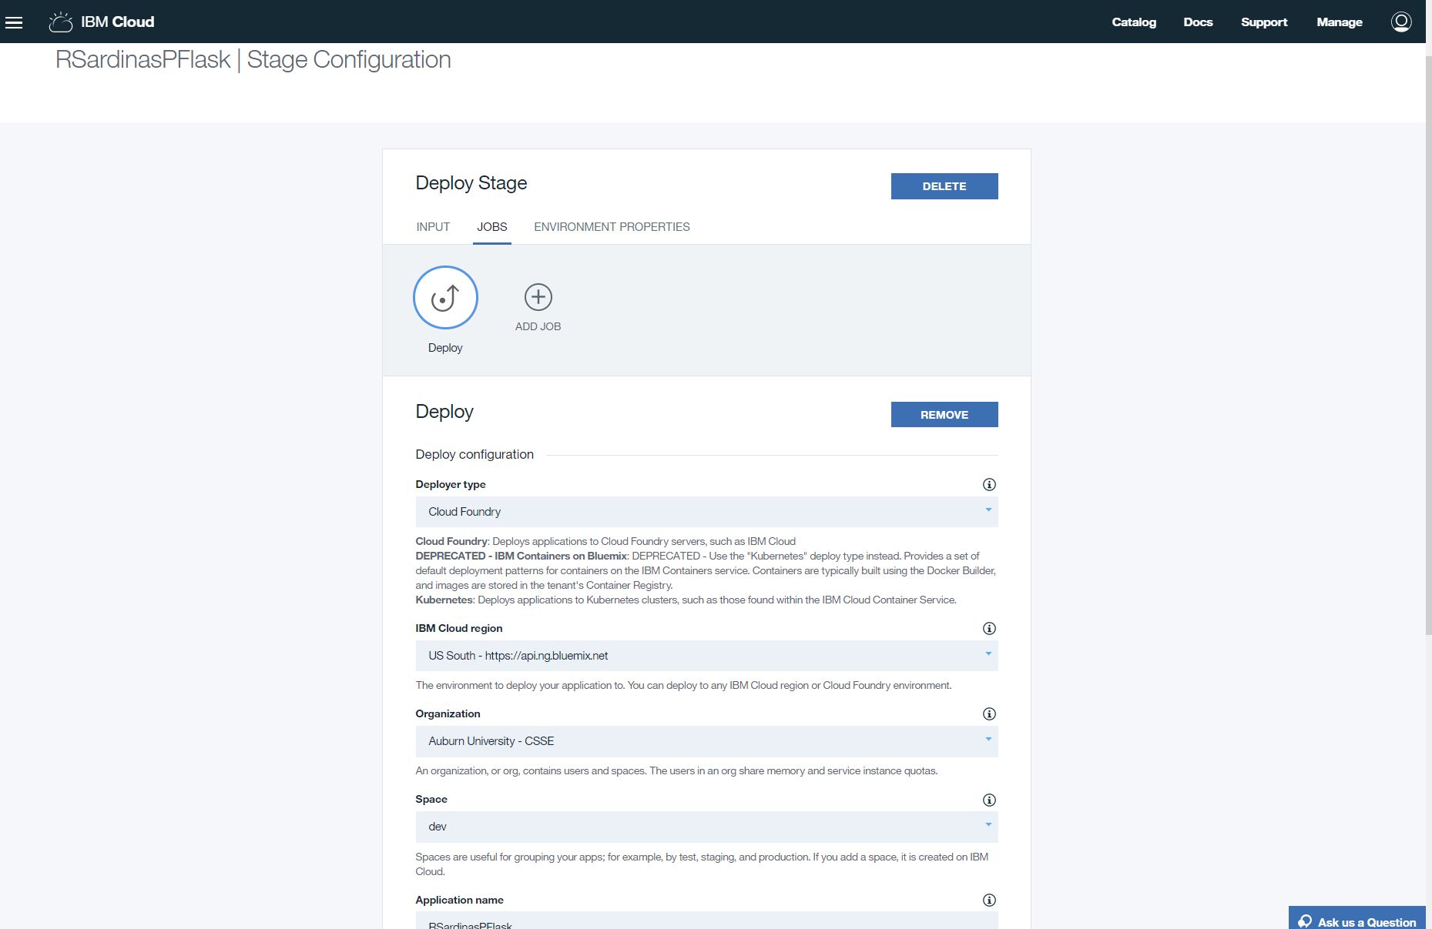
Configure Delivery Pipeline Deploy Stage Other Options

Slide 42
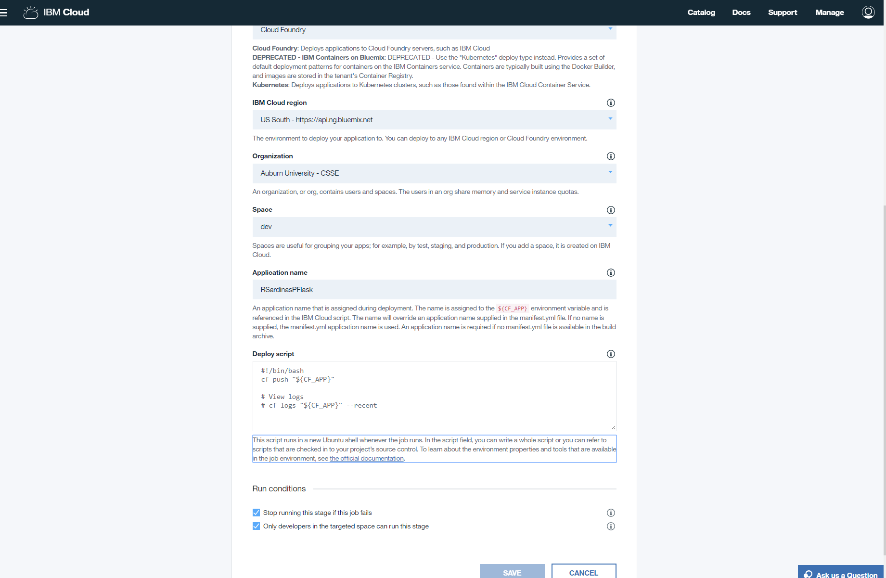
Configure Delivery Pipeline Deploy Stage

Slide 43
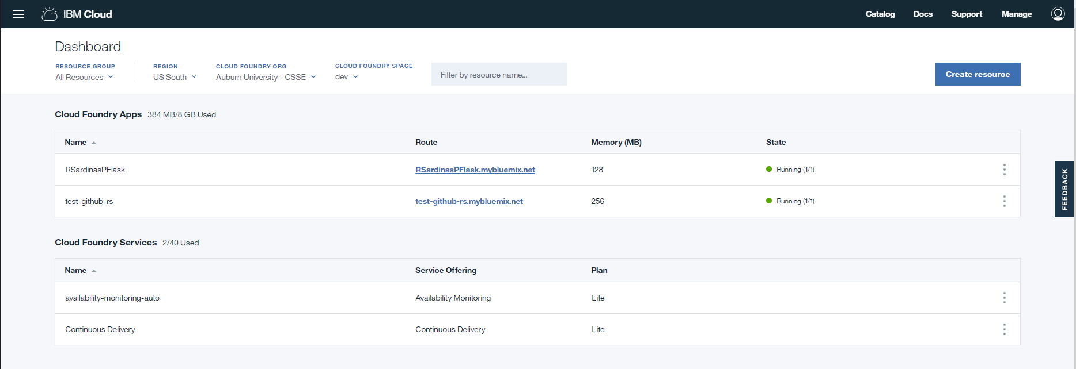
IBM Devops

Slide 44
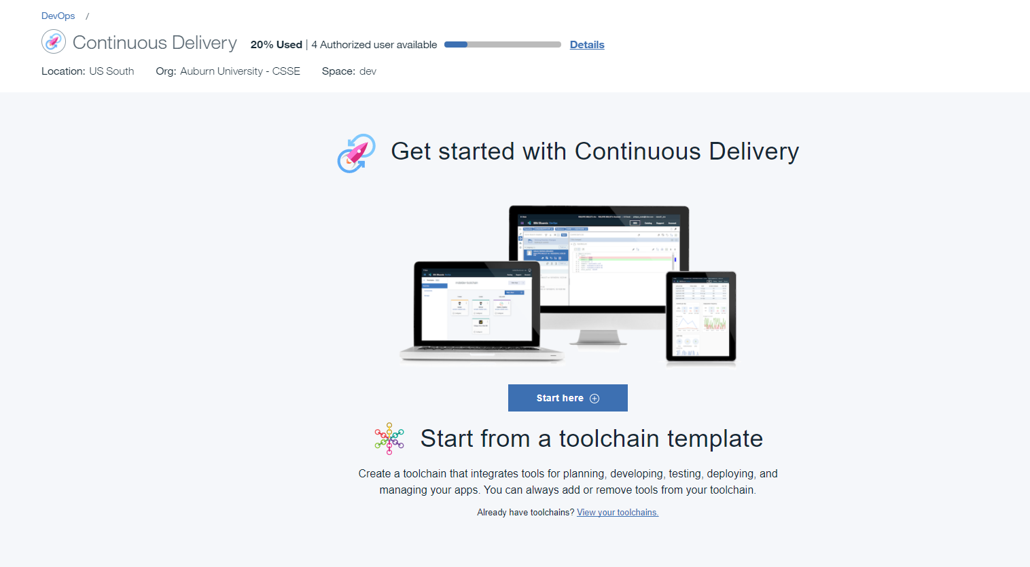
Toolchains

Slide 45
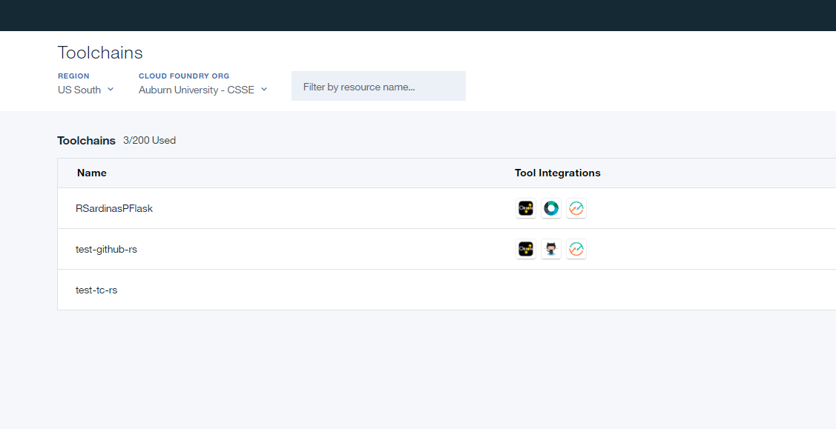
Existing Toolchains

Slide 46
Toolchains

Slide 47
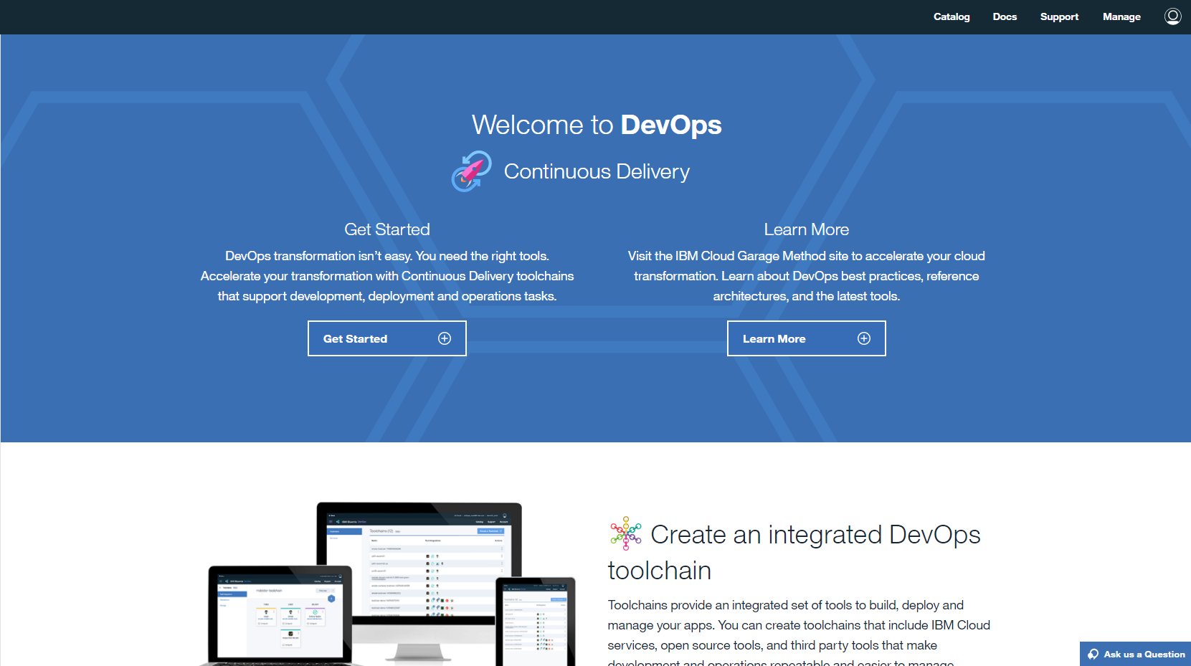
Create Custom

Slide 48
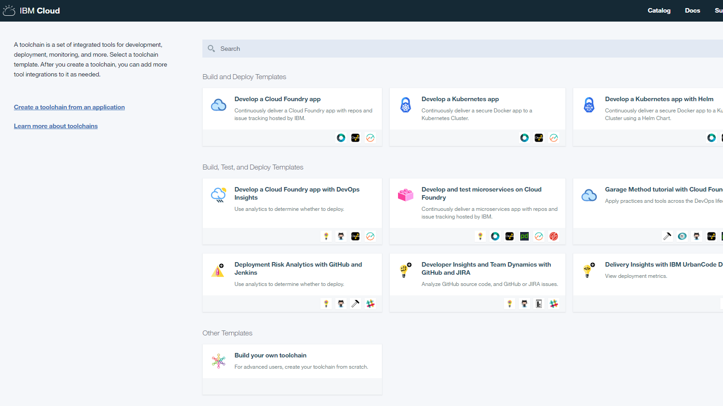
Custom Toolchains

Slide 49
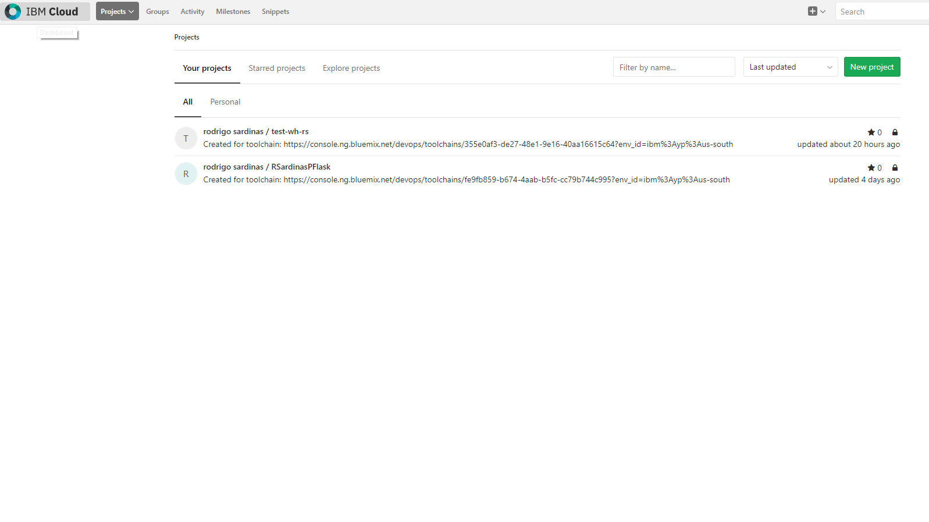
Where are my Repos!
https://git.ng.bluemix.net/

Slide 50
In-Class Demo
In-class demo moving from Private repo in IBM cloud to personal (classroom) github repo…

